Slide 1
COLLAPP
Aditya Patruni (Lead) | 221368897
Akshitha Duddala | 571933326
Anisha Siddapurmath | 500681255
Hemant Pattnaik | 770755090
Jaysheel Shah | 971222875
Nikhil Bharadwaj | 469484436
Setu Desai | 711833313

Slide 2
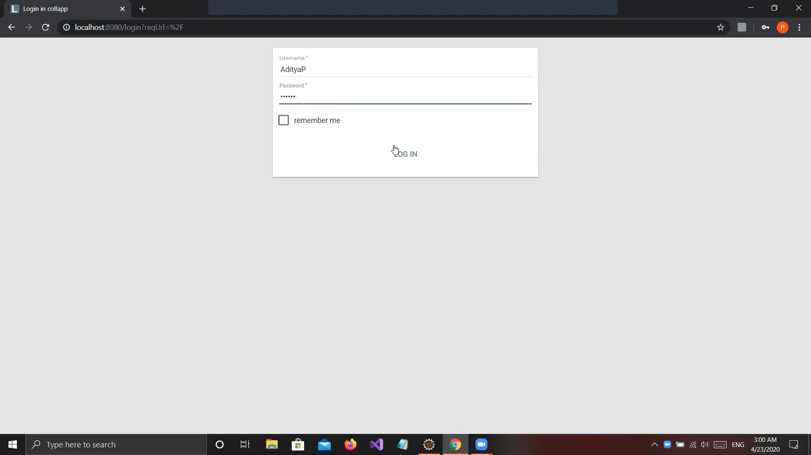
Login
User uses their username and password to connect to the server and use the COLLAPP application

Slide 3
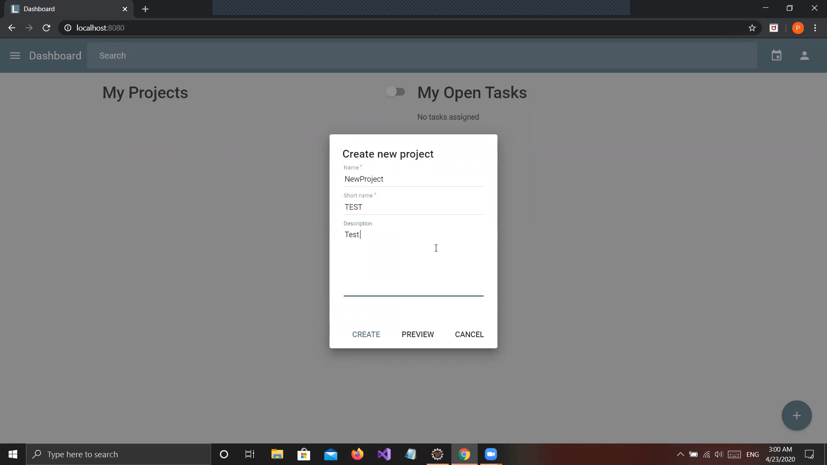
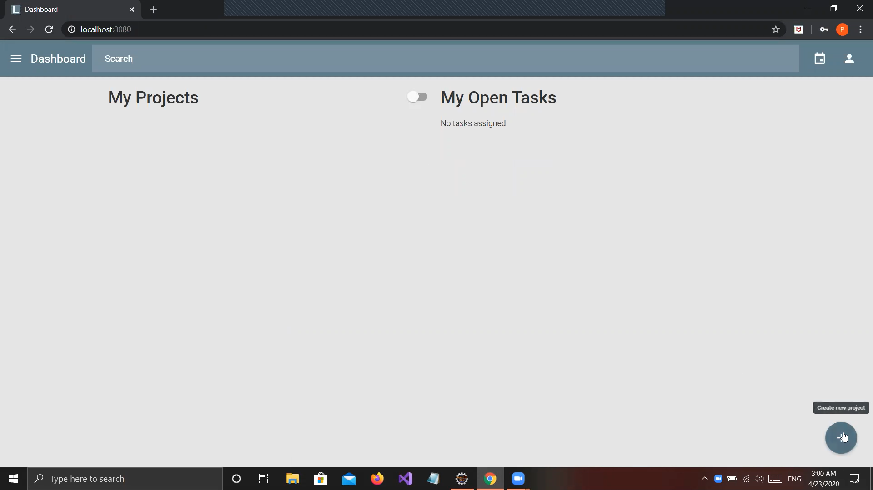
Add New Project
Creates a new project on selecting the + at the bottom left. The name and short name are input by the admin. An optional description can also be given.

Slide 4
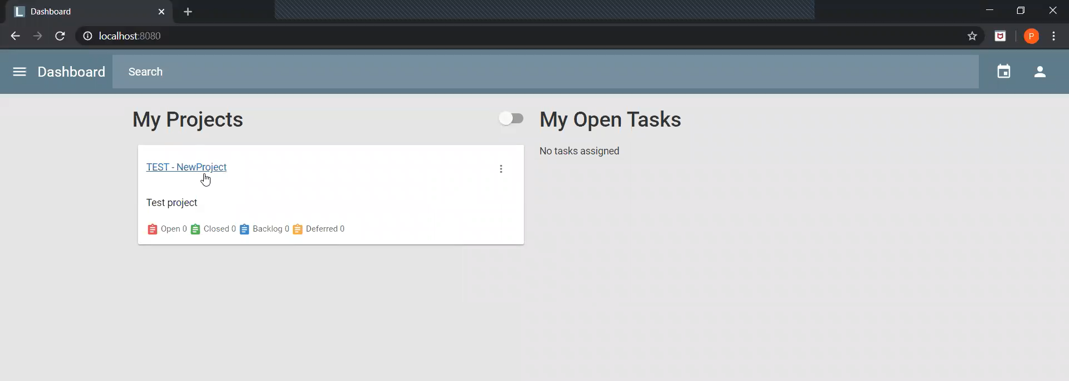
Dashboard
Dashboard shows all the ongoing projects. It also shows the status of the project.

Slide 5
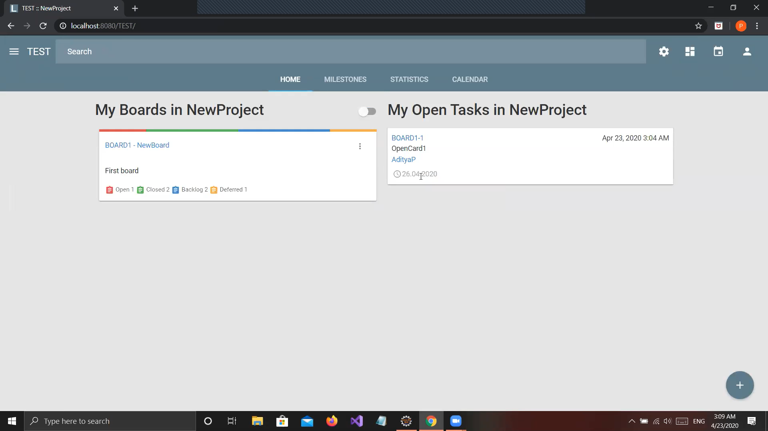
Project Dashboard
Selecting a project takes you to the project dashboard
It has four tabs – Home, Milestones, Statistics and Calendar

Slide 6
Home Tab
It shows ongoing tasks in the project along with their columns, cards and status
It also allows you to create new tasks

Slide 7
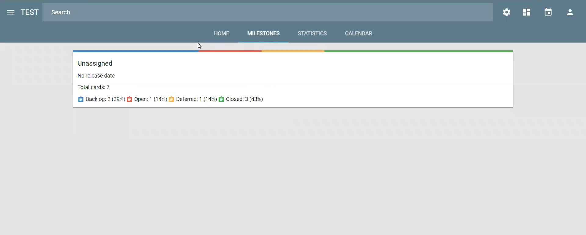
Milestones Tab
Shows the progress of the project

Slide 8
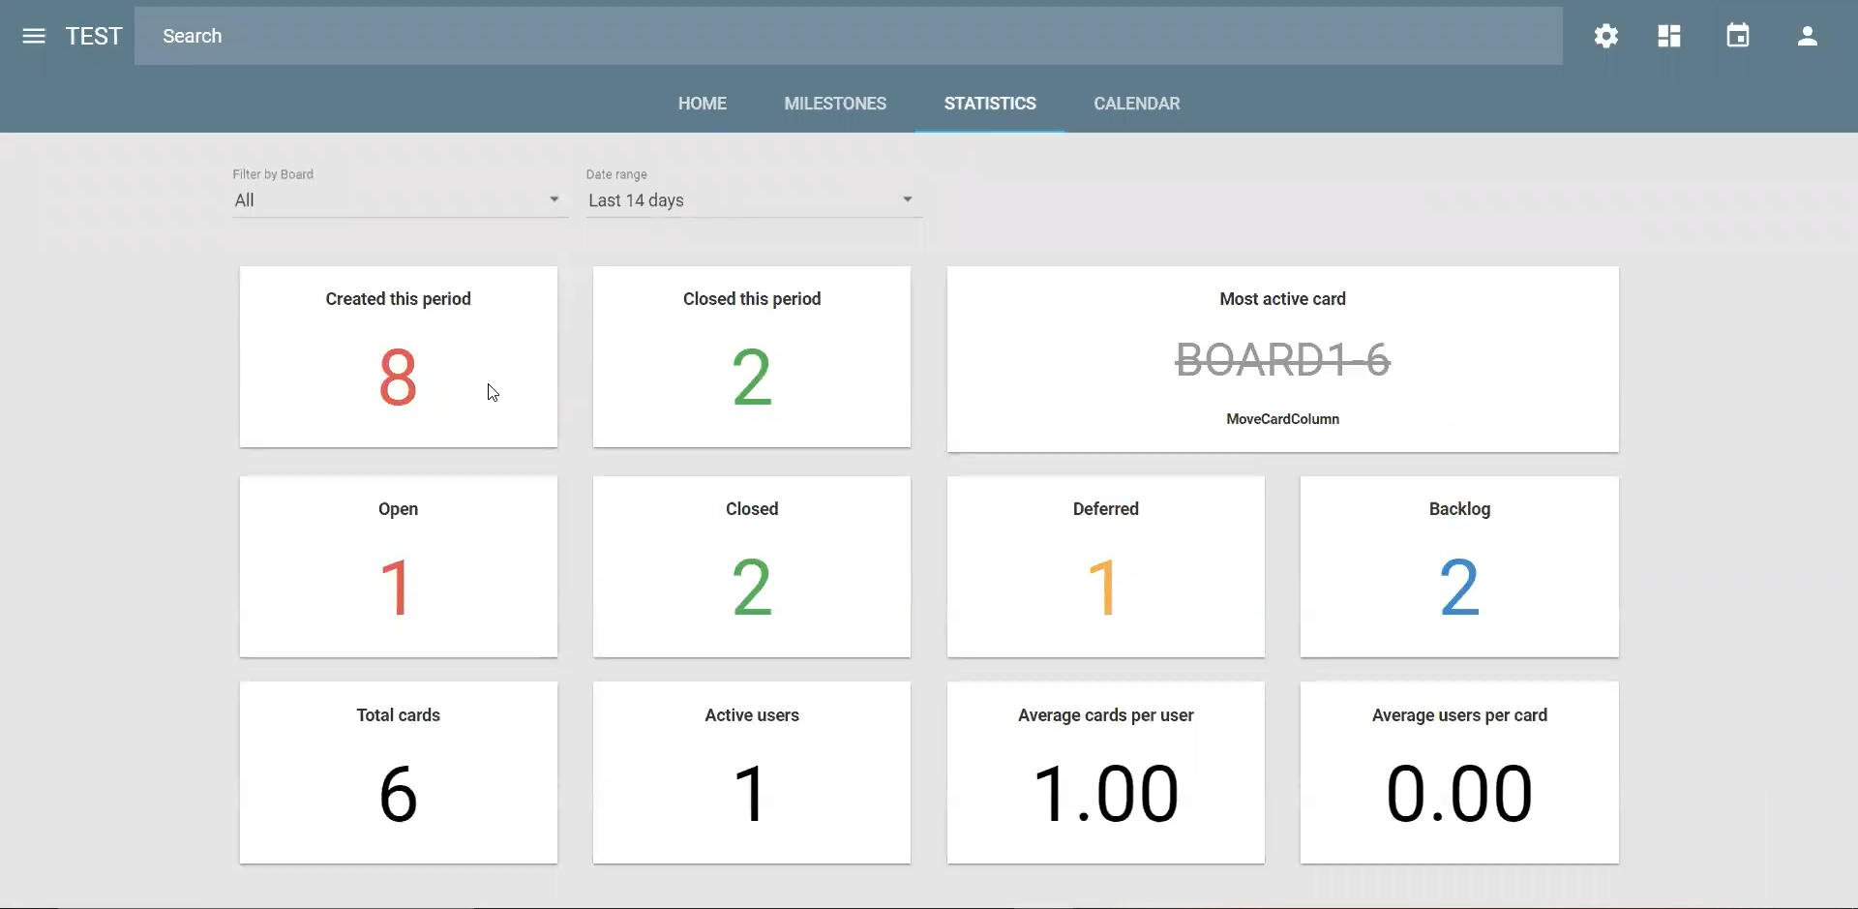
Statistics Tab
Shows the statistics of the tasks/boards of the project
There is an option to view the statistics of selective boards
There is also an option to select a time duration for the statistics

Slide 9
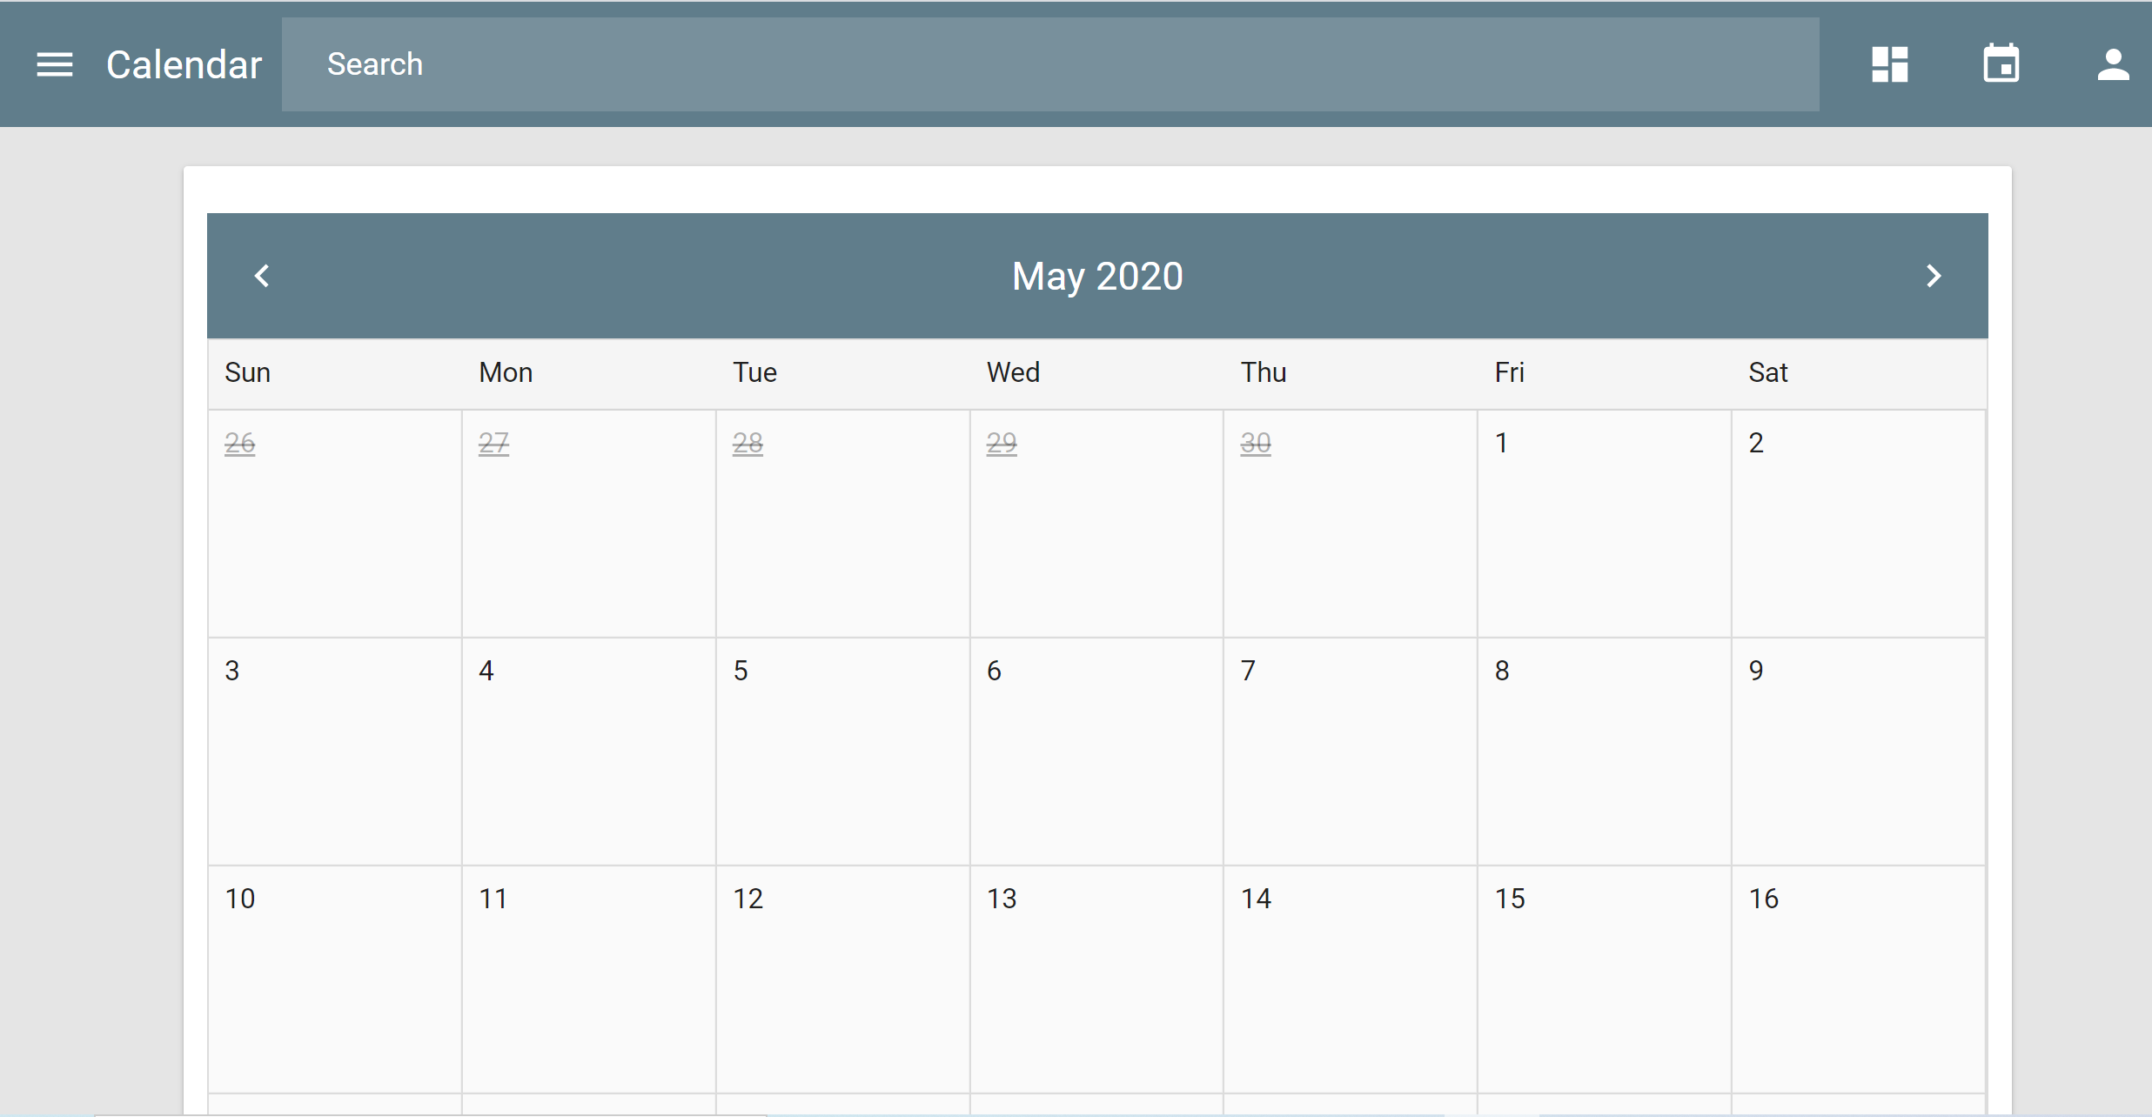
Calendar Tab

Slide 10
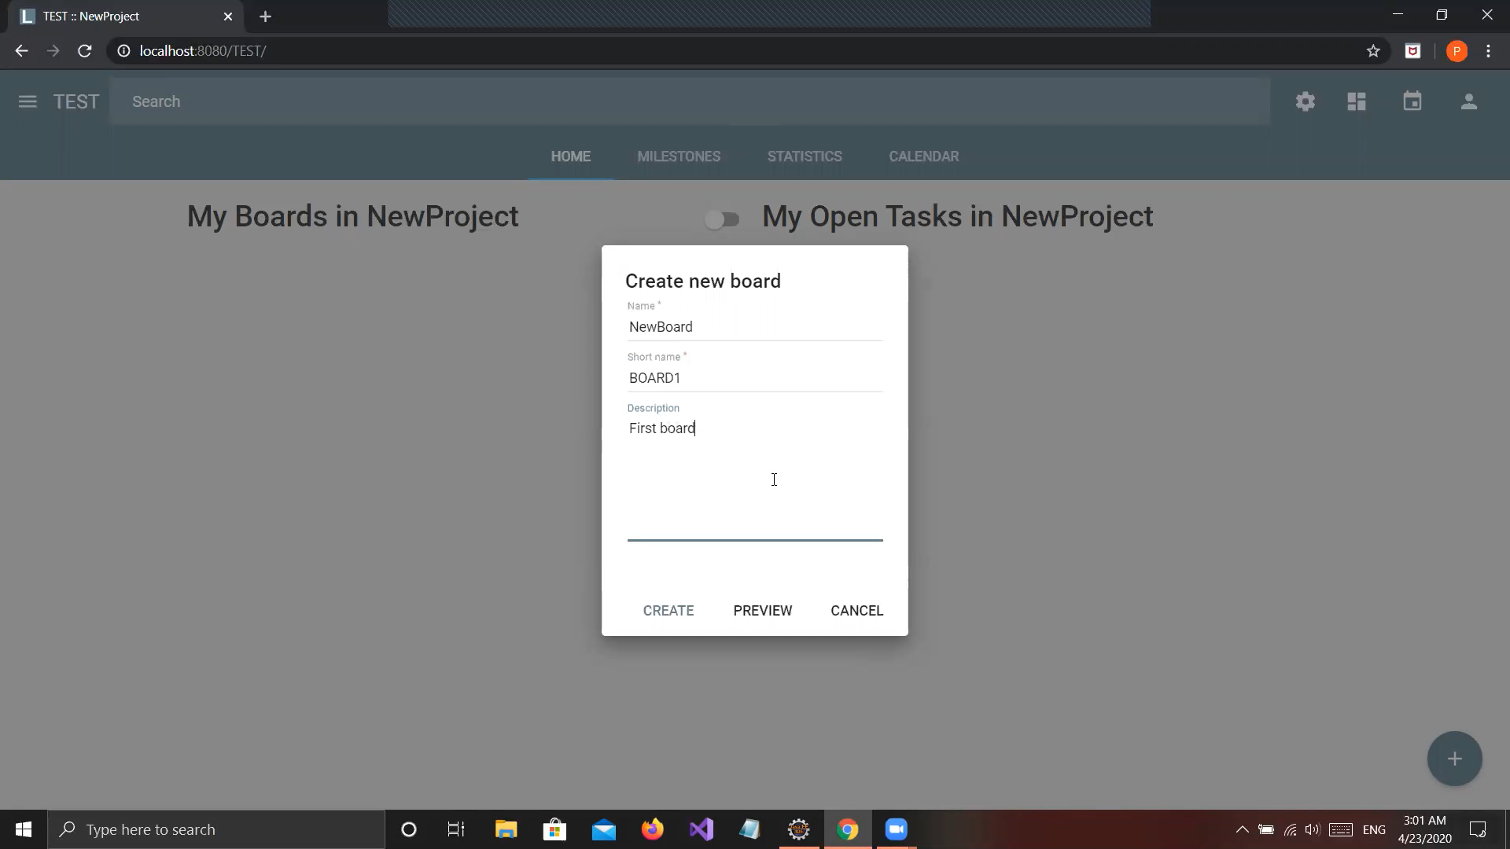
Create A Task/Board
Creates a new task inside the project on selecting the + at the bottom left.
The name and short name are given by the user.
An optional description can also be given.

Slide 11
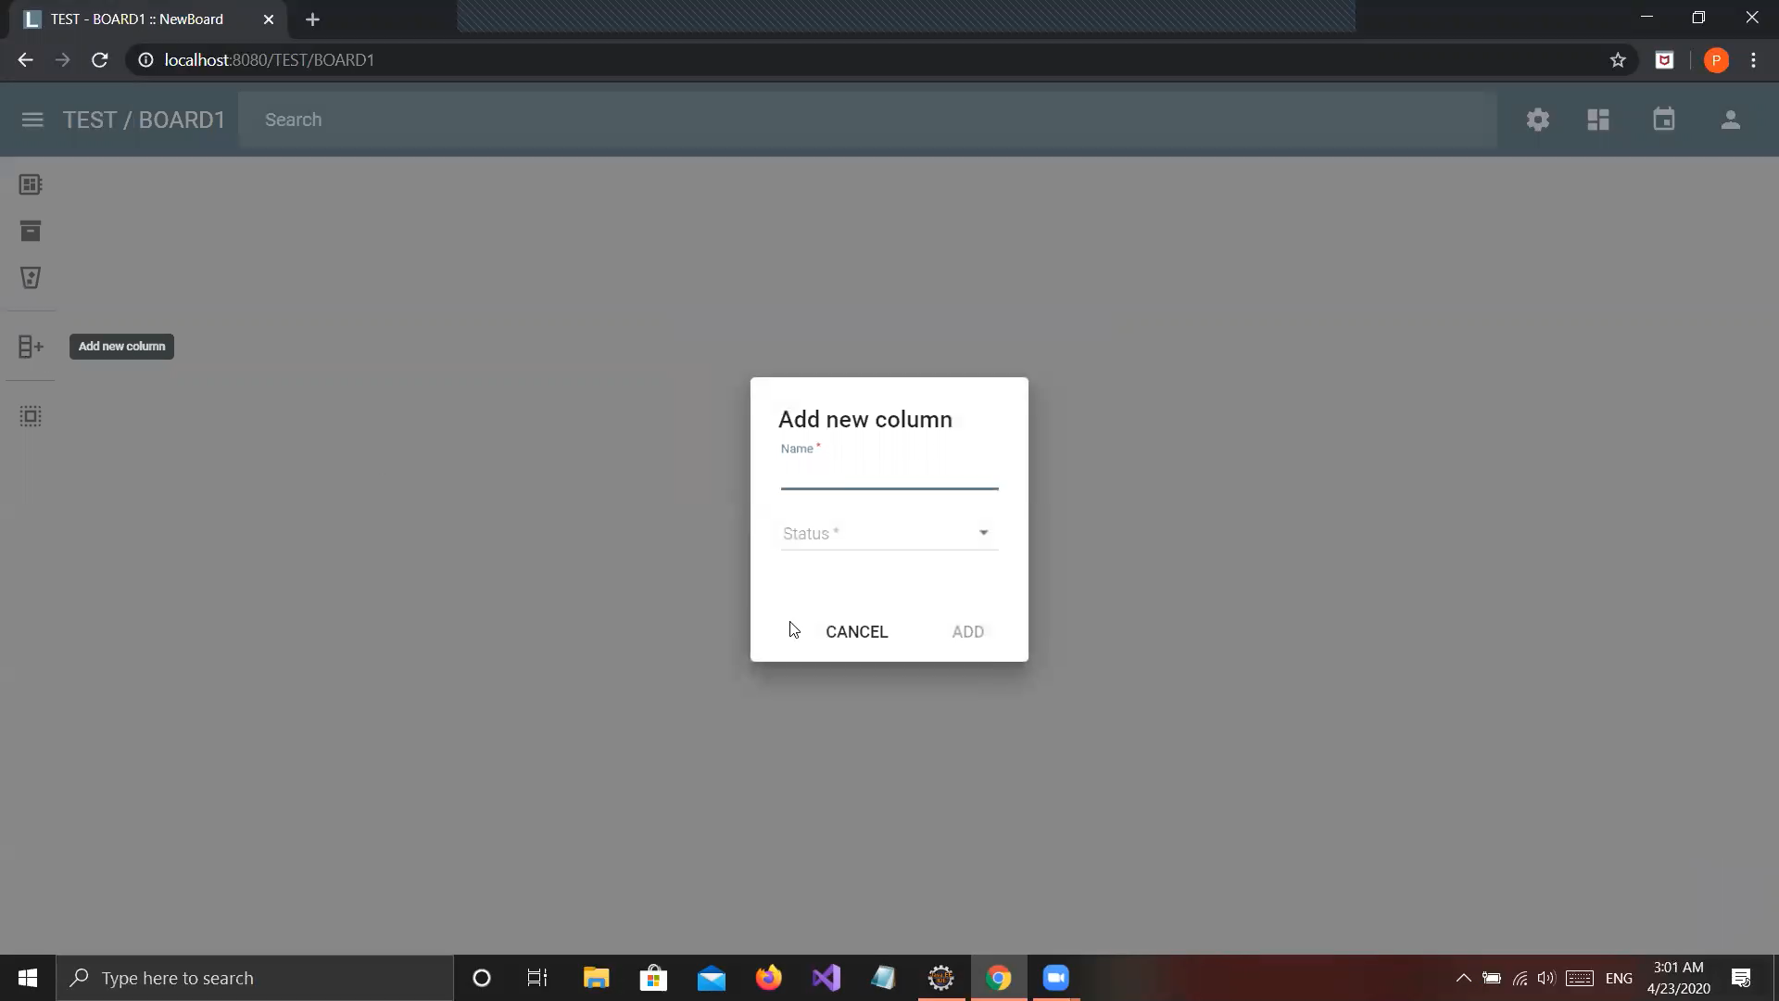
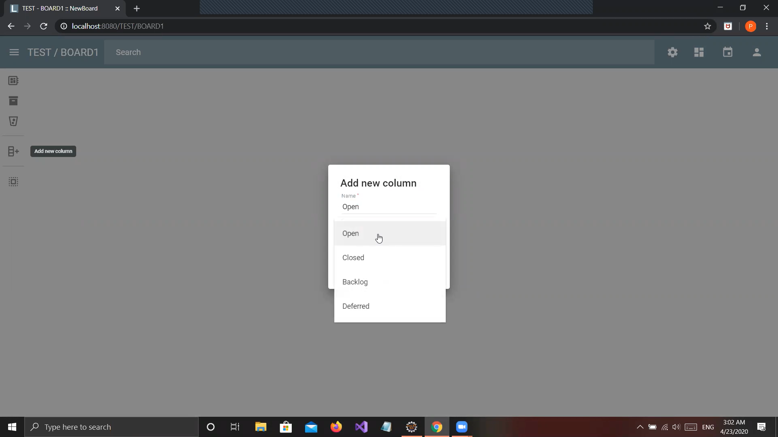
Create Column
On selecting the add new column tab to the left, a new column is created
Column depicts a task inside the project
The column is given a name and the status can be set from the drop-down menu

Slide 12
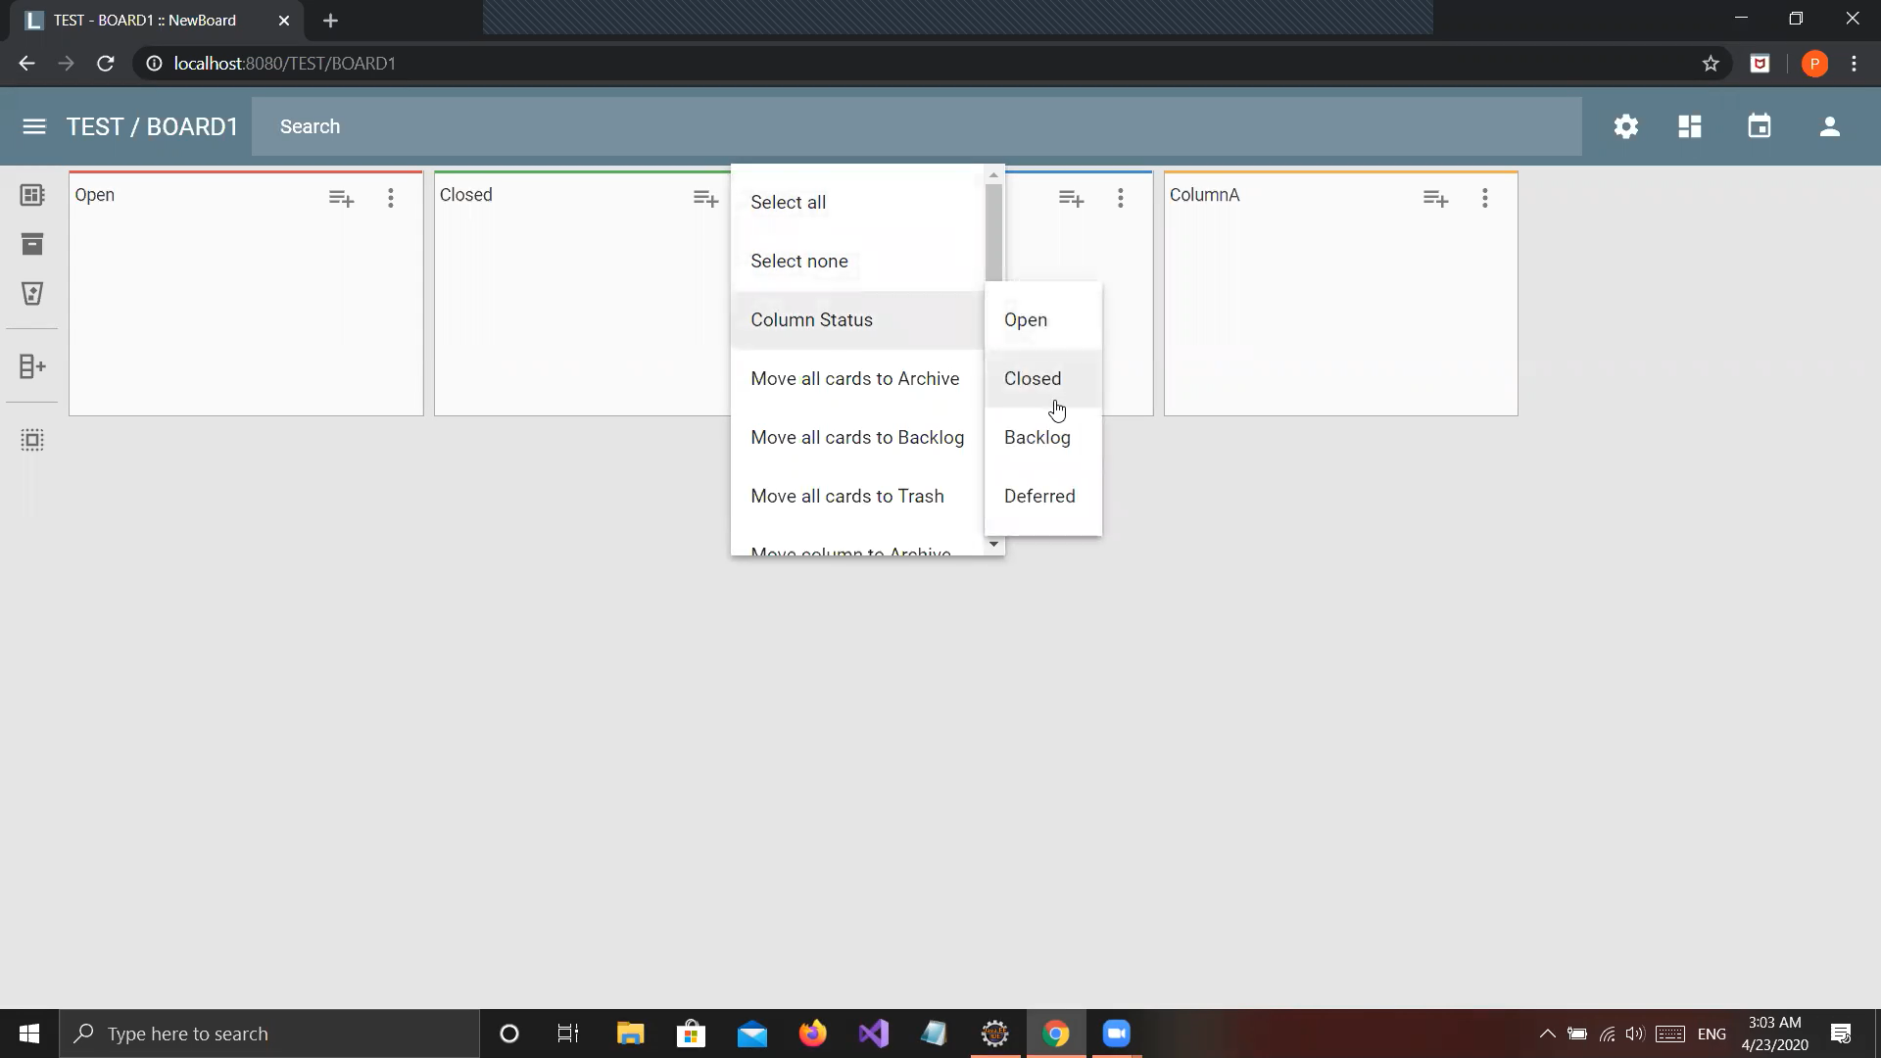
Task/Board Dashboard
Task Dashboard shows all the columns created inside the project
Each status is represented in a different color
Changes can also be made to the columns on this screen

Slide 13
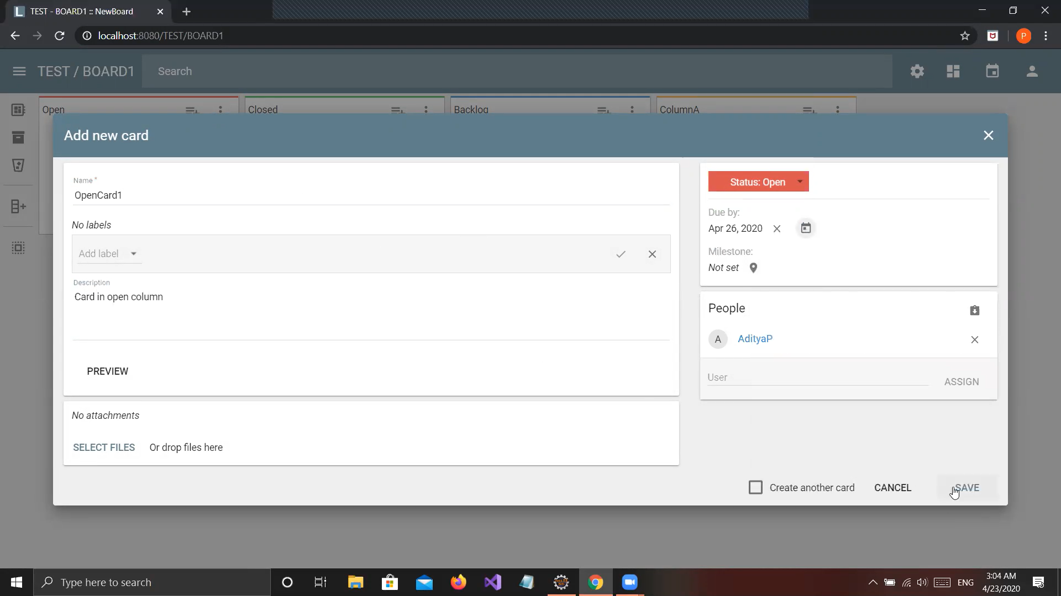
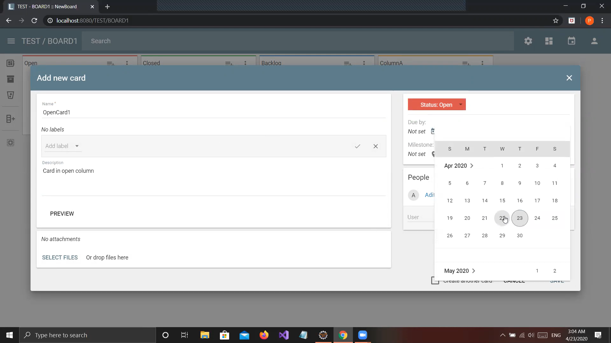
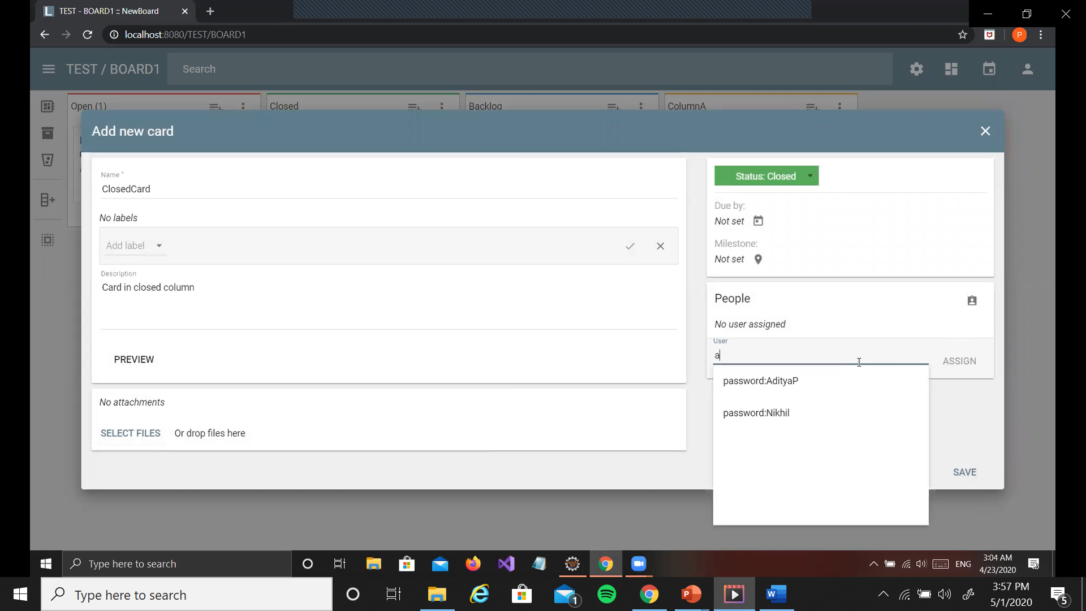
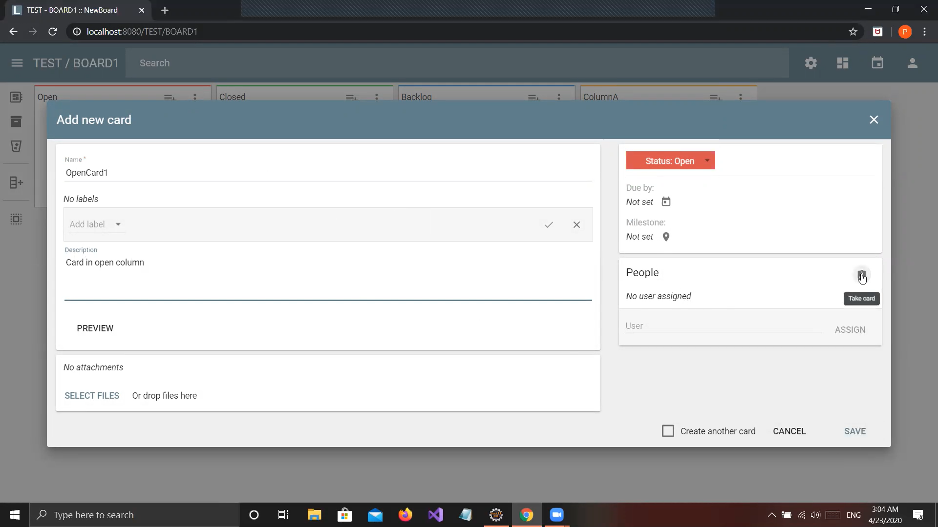
Create Card
On selecting the add new card tab, the 2nd tab from right at the top right of the column, a card is created
Specifications regarding it are entered
Due date for the card is set from the drop-down calendar
Person assigned can be the person creating the card (take card option) or another person can be assigned to it
Files can also be attached

Slide 14
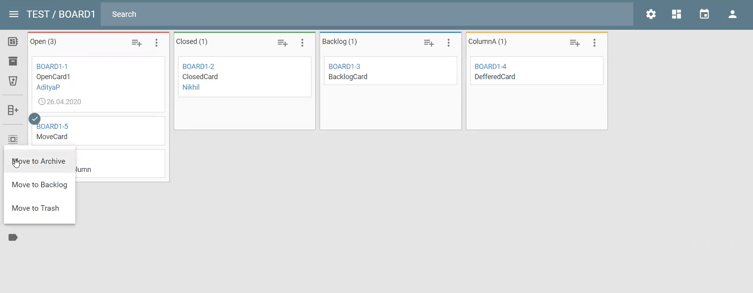
Move Card
Card once created can be moved to trash, backlog or archive

Slide 15
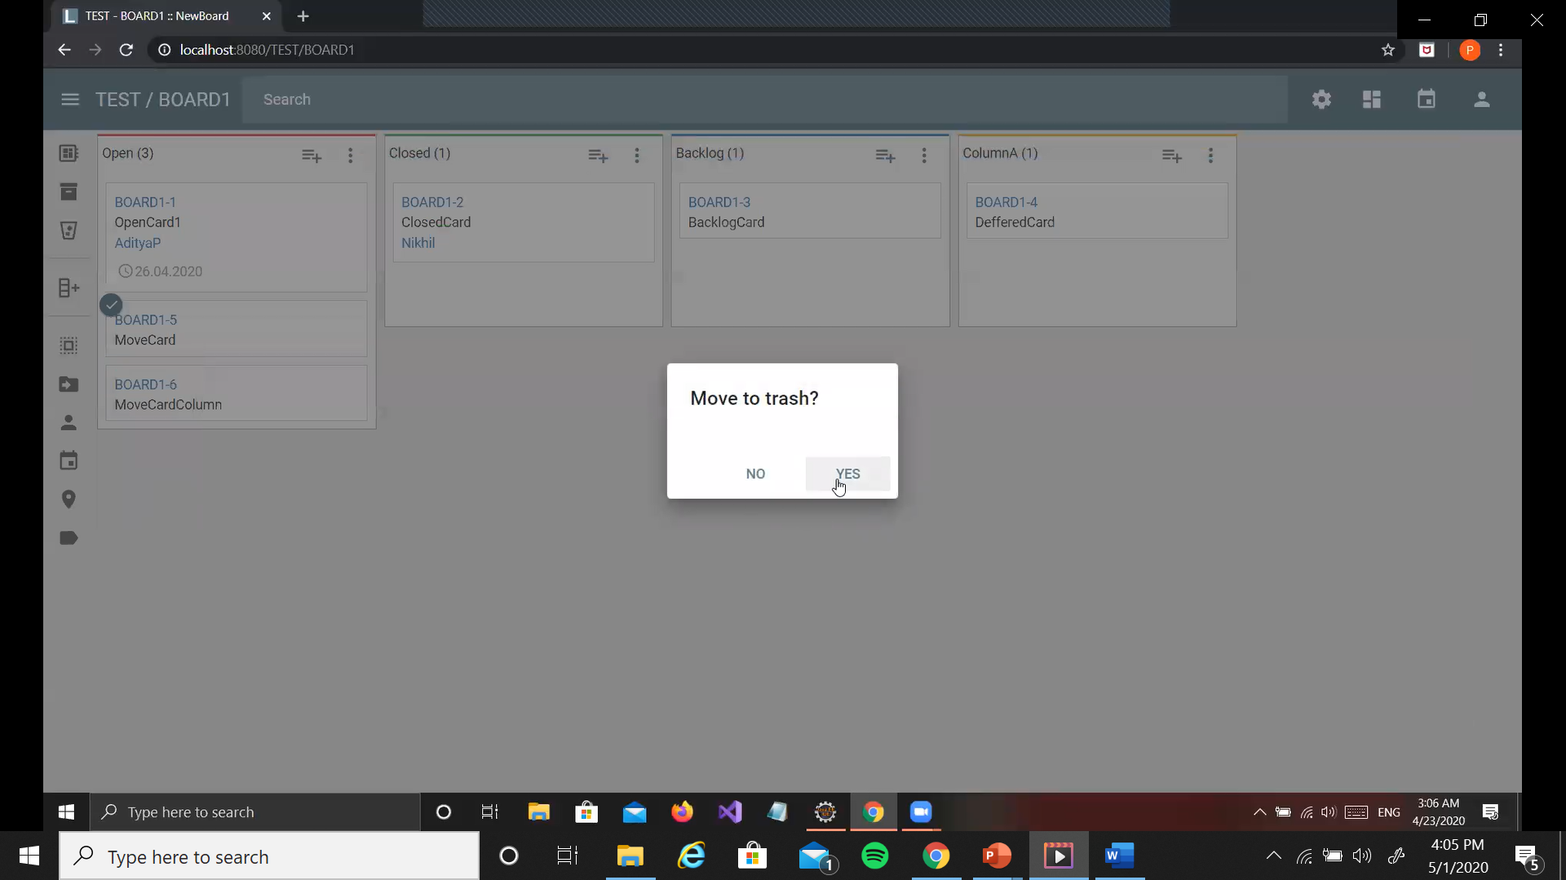
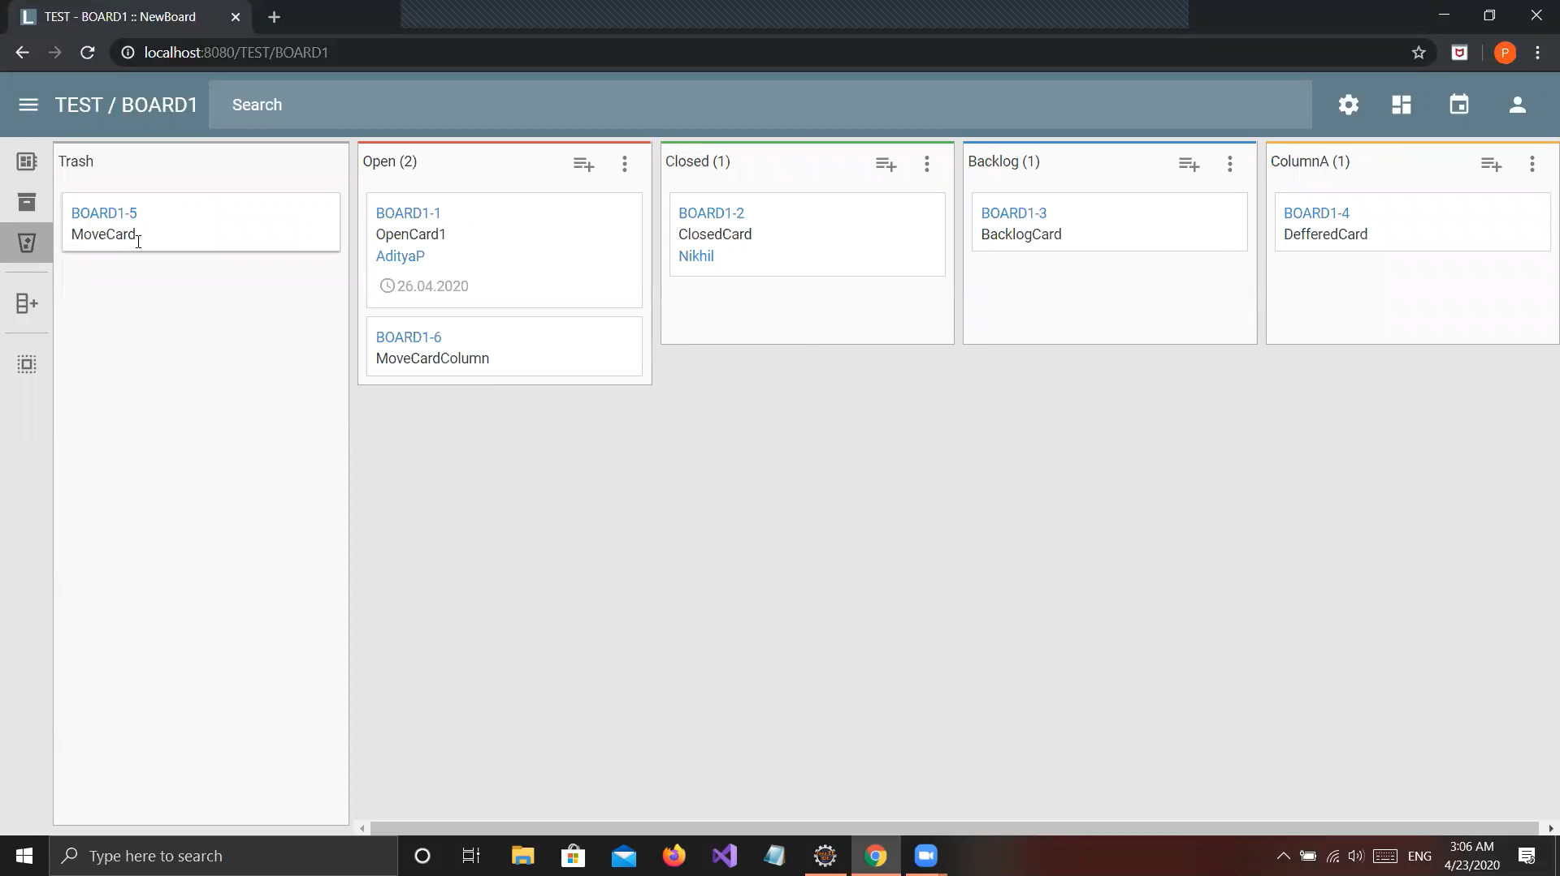
Move Card To Trash
On moving a card to trash a prompt shows up
On selecting yes, the card is removed from the column dashboard and is now in trash

Slide 16
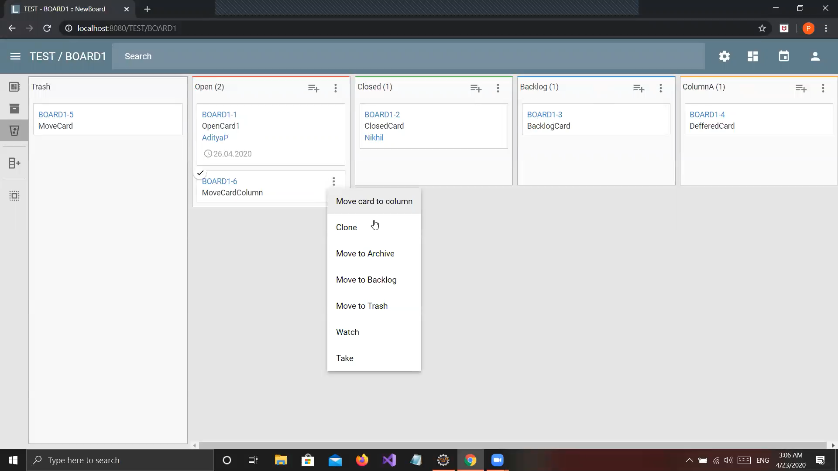
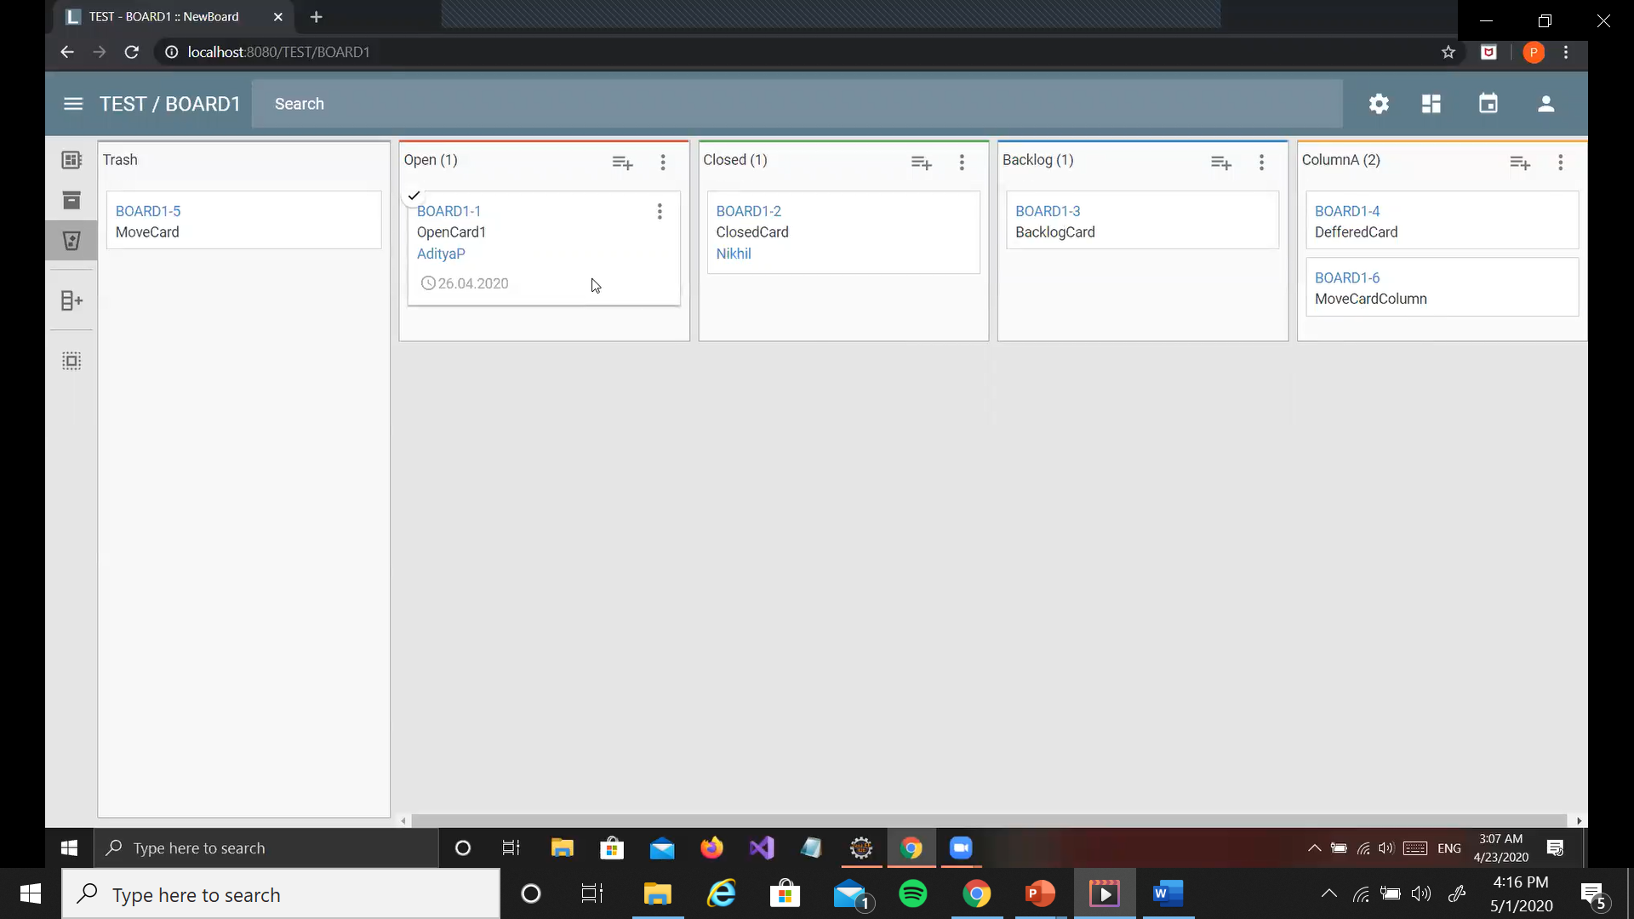
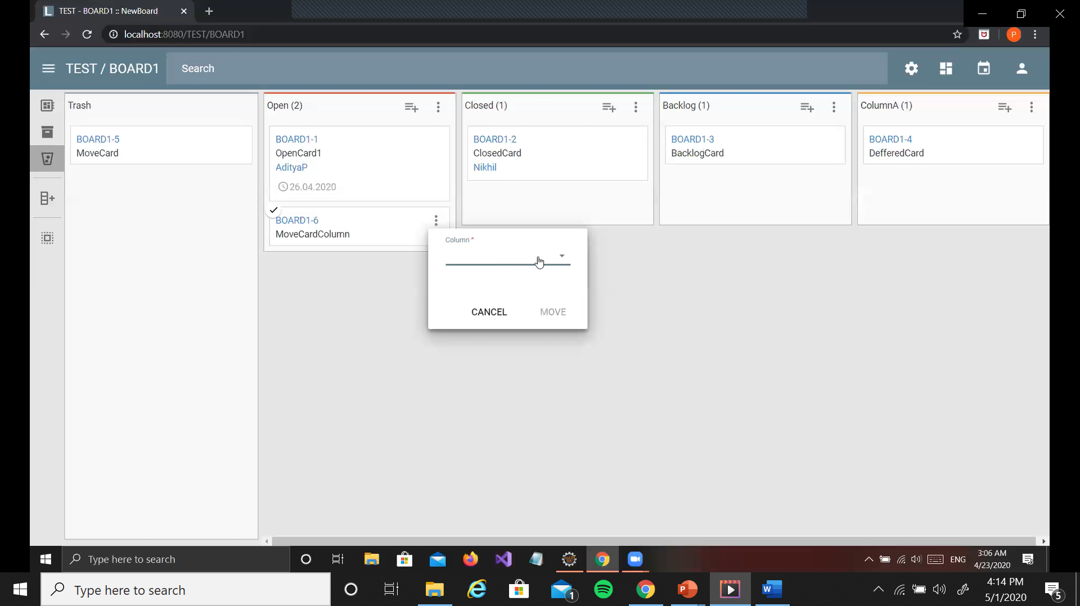
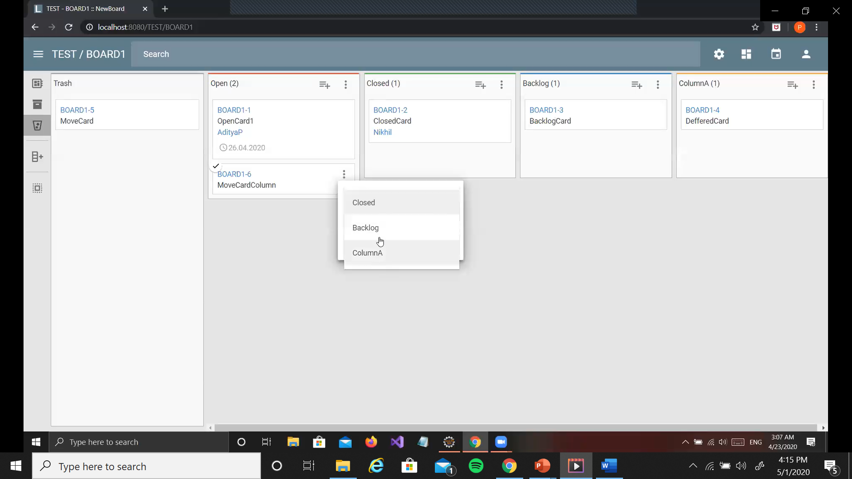
Move Card To Column
Card can be moved to another column
The column it must be moved to selected from the drop-down menu of the columns in the project
Once moved, the card appears in the column it has been moved to

Slide 17
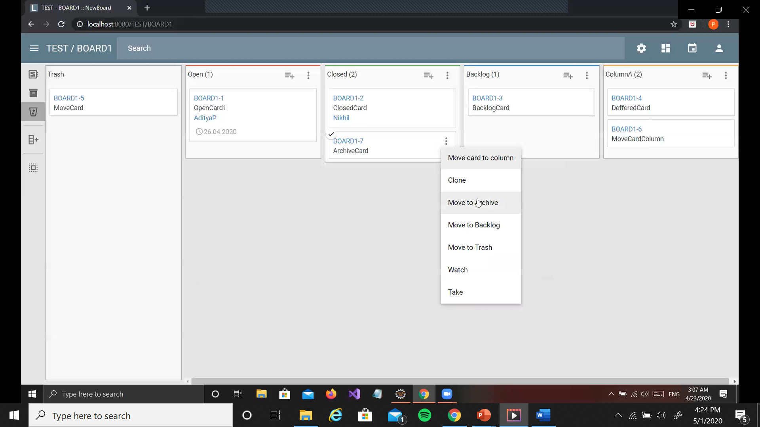
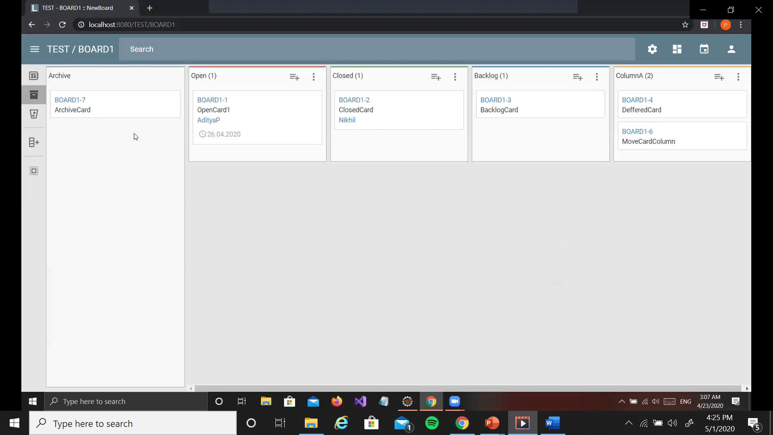
Move Card To Archive
Card moved to the archive disappears from the current column and appears in the archive

Slide 18
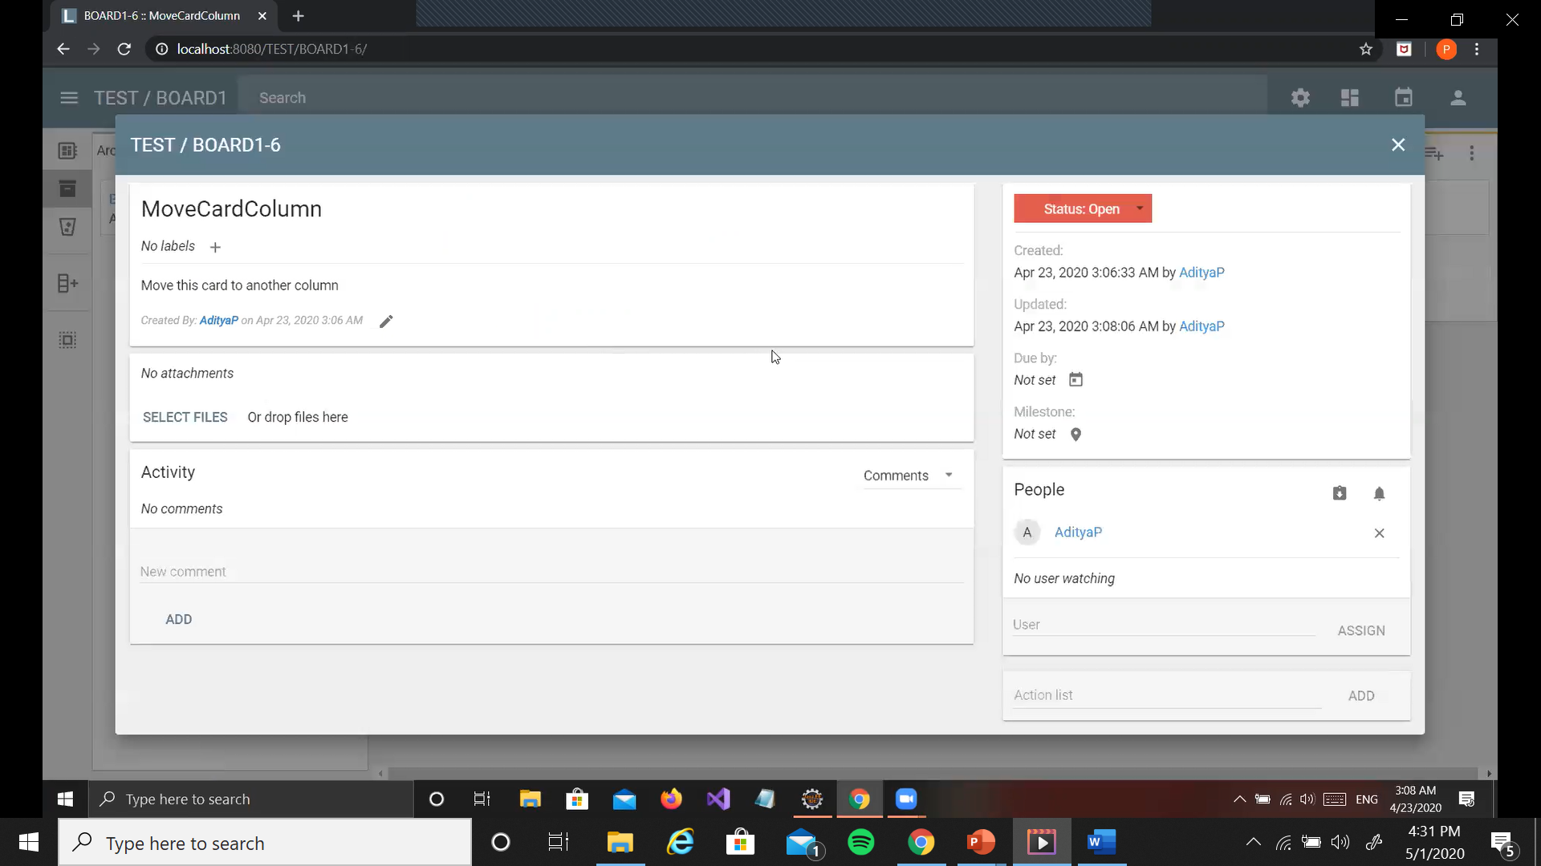
Update History Of A Card
Update history of a card can be seen on selecting that card

Slide 19
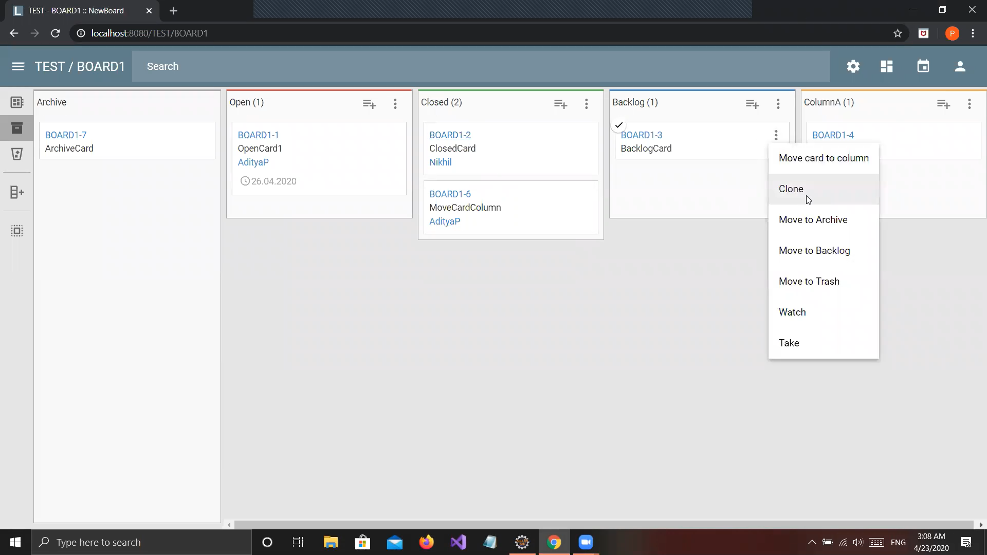
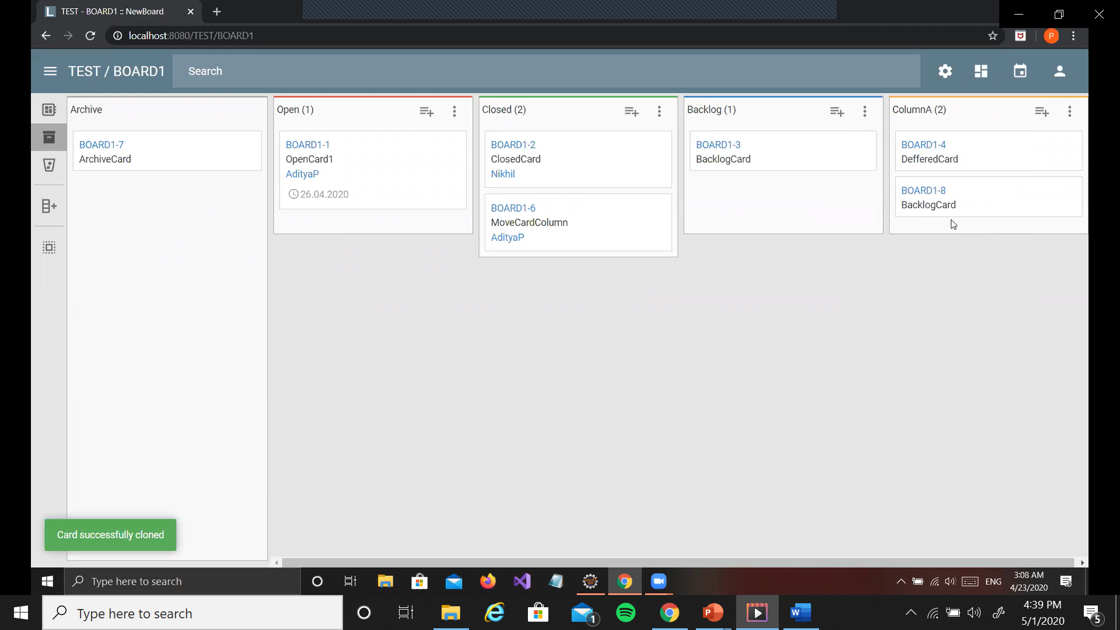
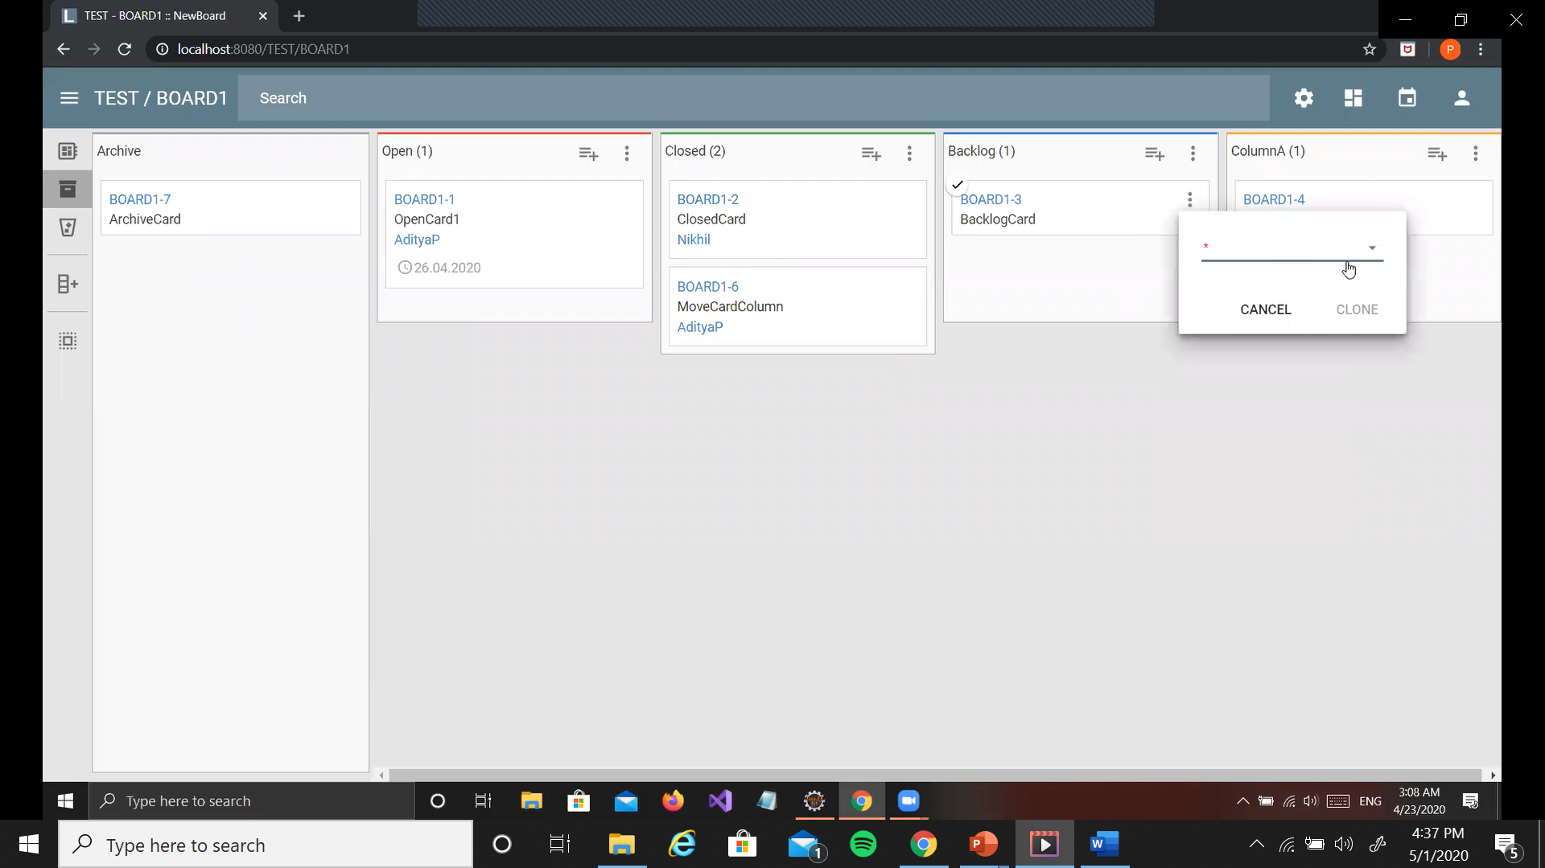
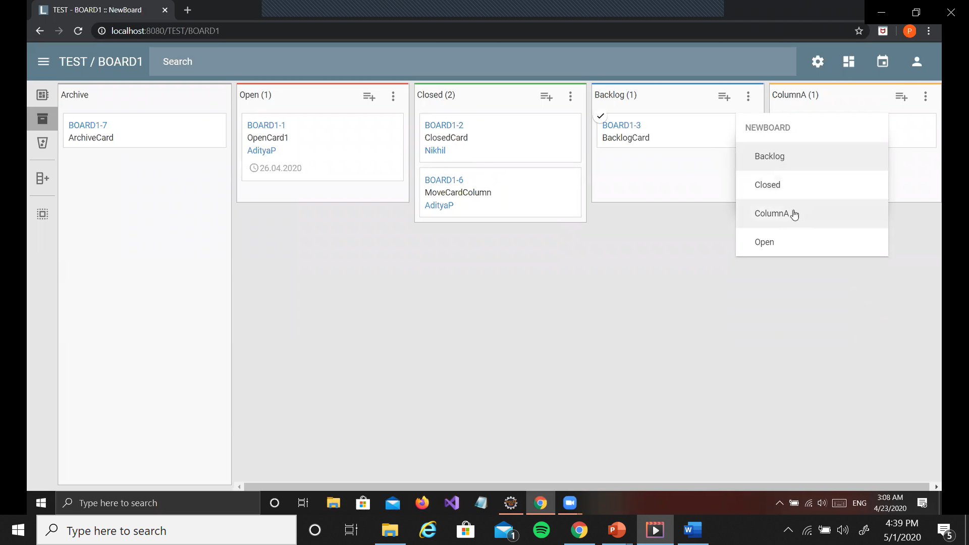
Clone A Card
Copy of the card is created in the same or another column
The column is selected through a drop-down menu

Slide 20
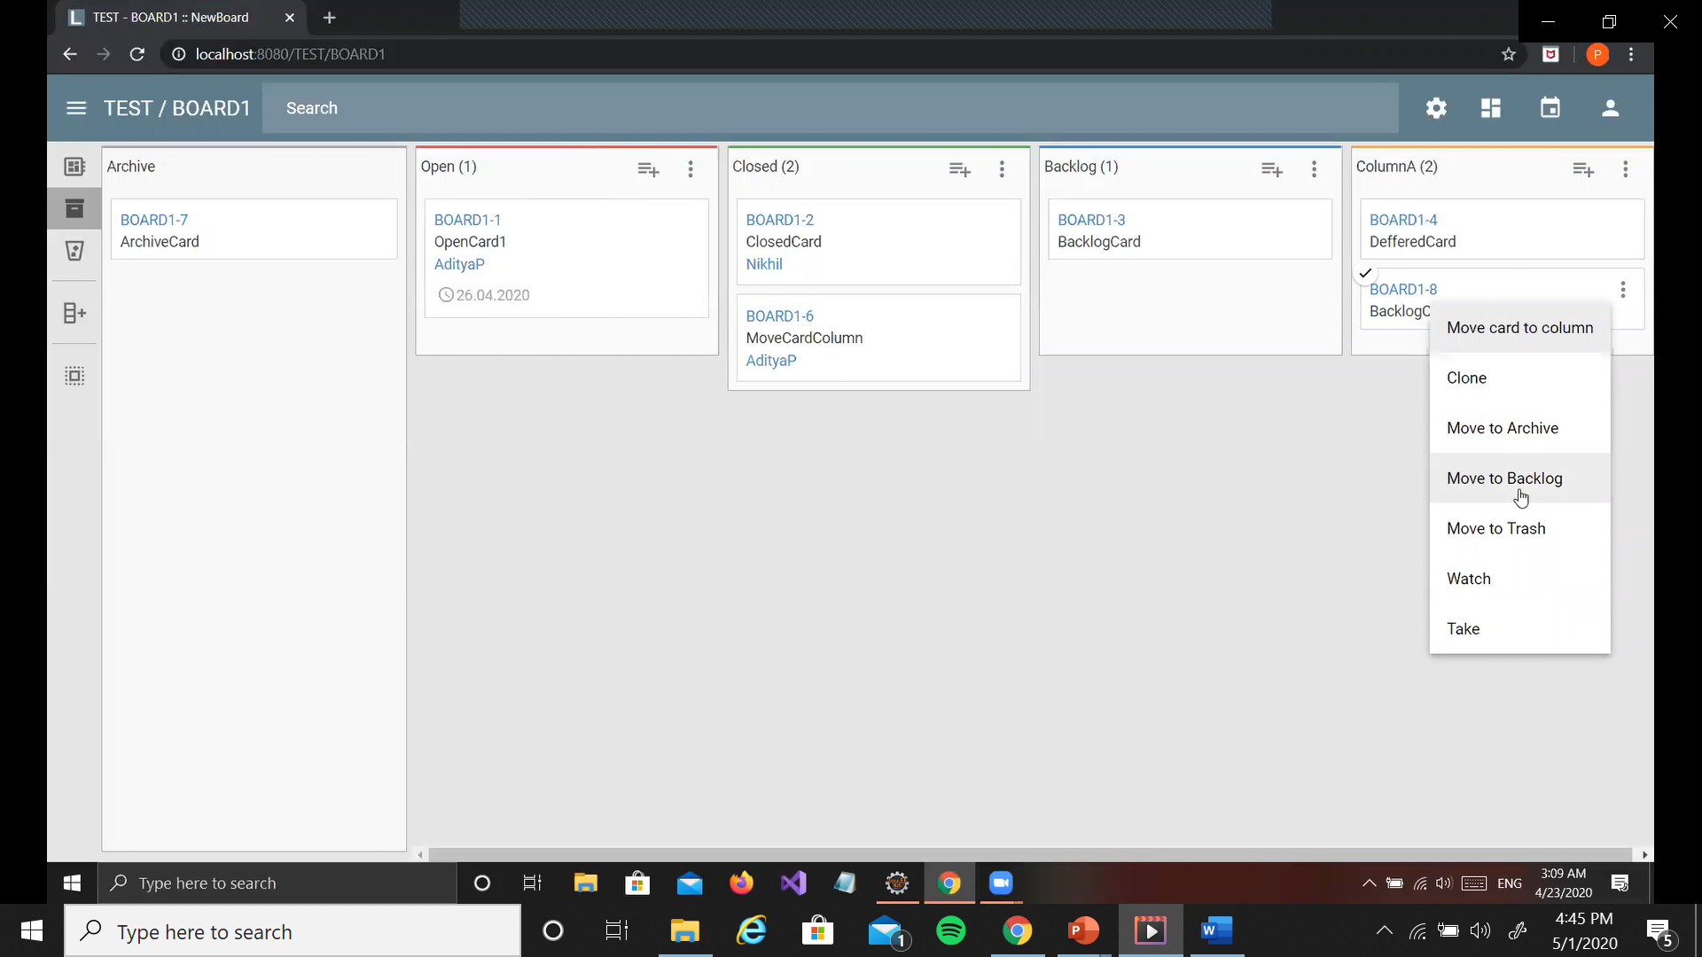

Move Card To Backlog
Card moved to the backlog disappears from the current column
All the backlog cards are placed together

Slide 21
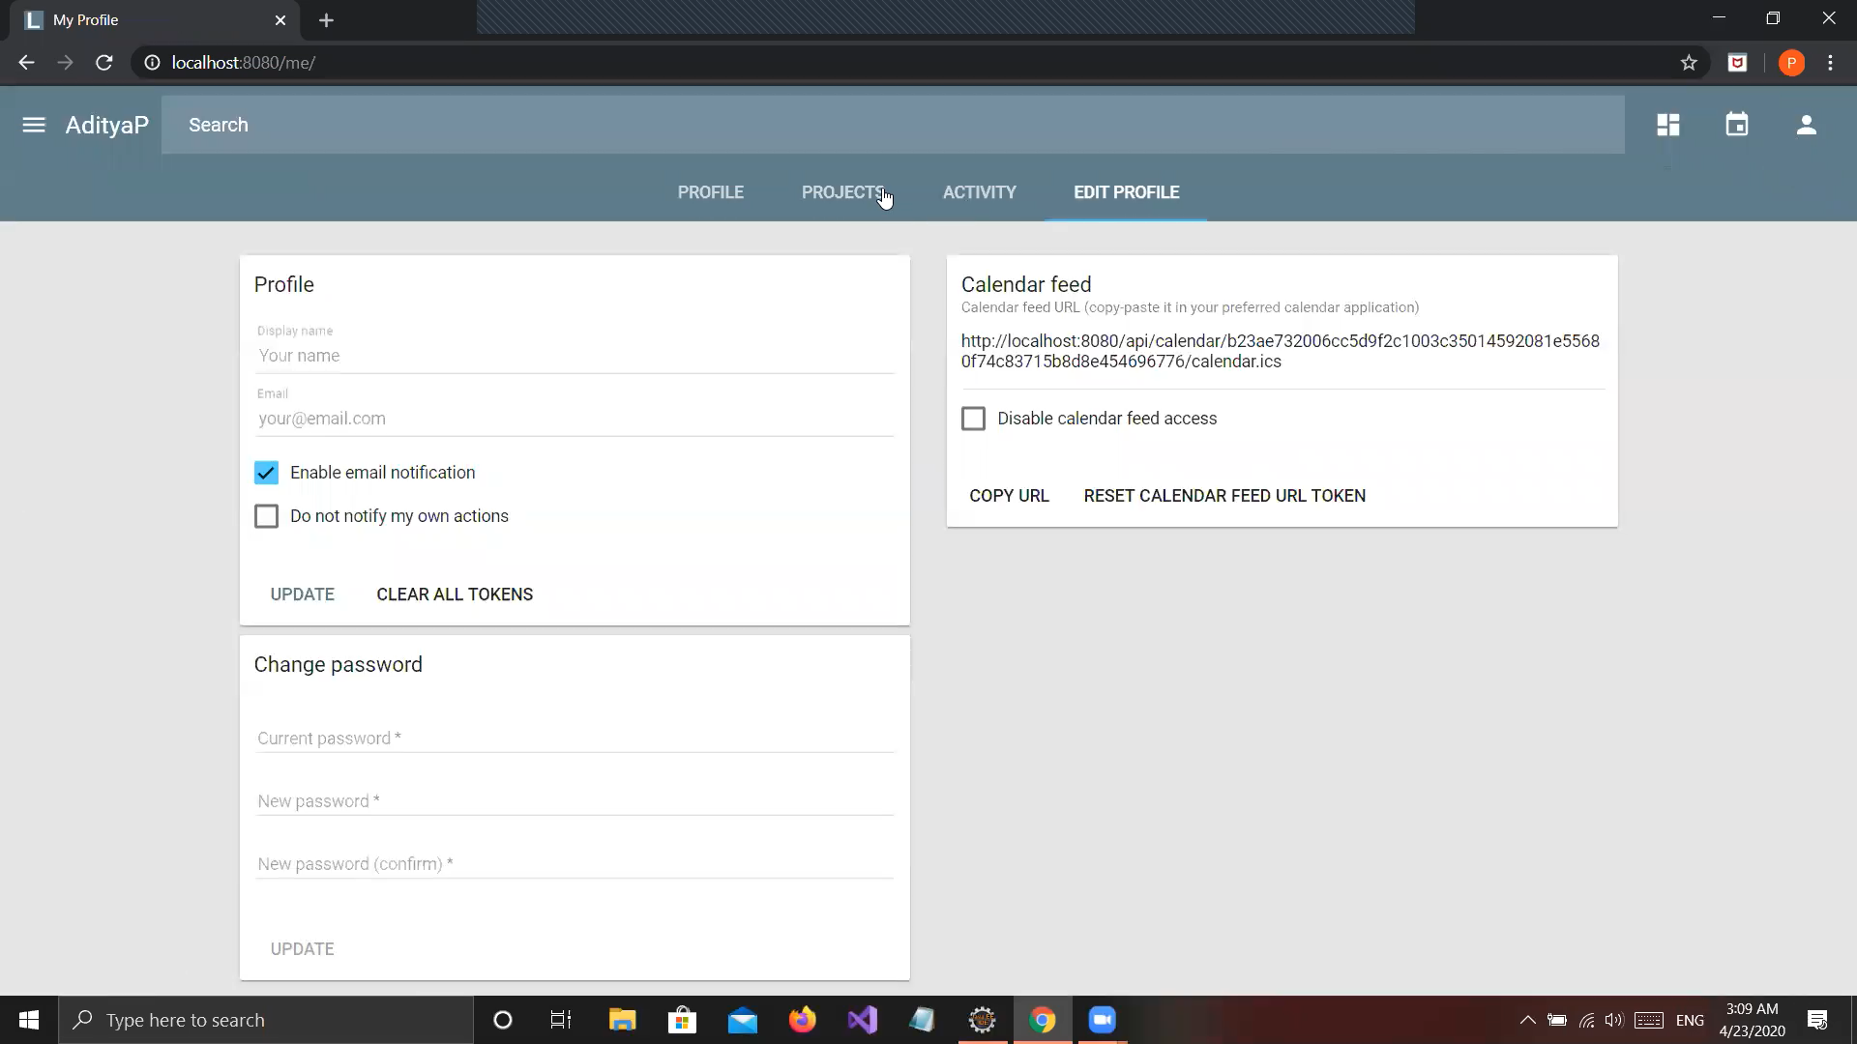
User Dashboard
Selecting the top right logo of a person or selecting my profile from the menu takes you to the user dashboard which contains four tabs – profile, projects, activity and edit profile

Slide 22
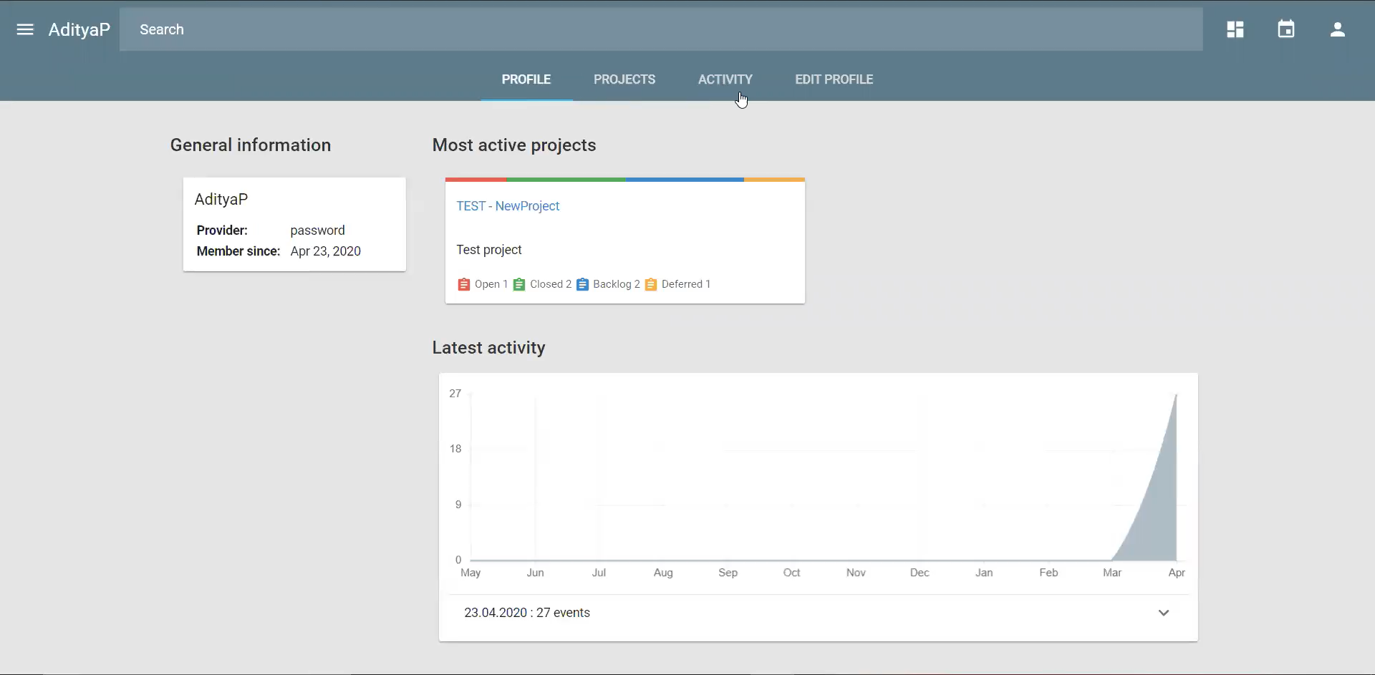
Profile Tab
Shows information about the user, activity over the year and the most active project

Slide 23
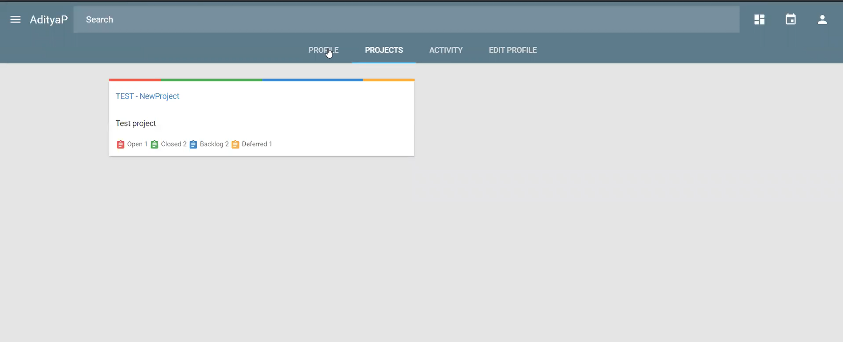
Projects Tab
Shows all the projects associated with that user

Slide 24
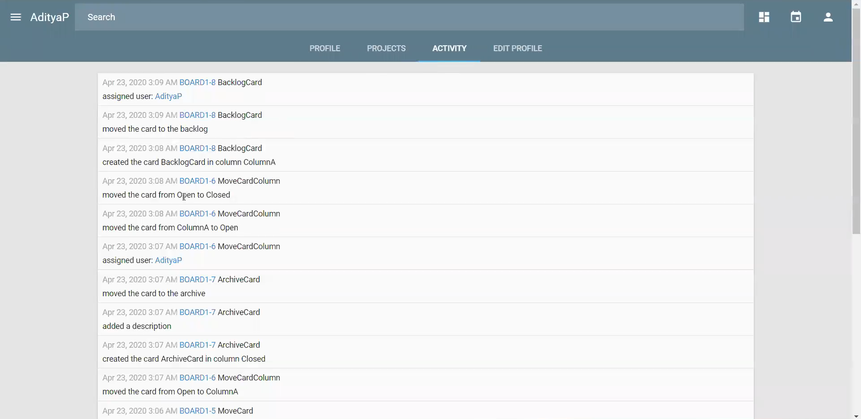
Activity Tab
Shows the detailed activity of the user

Slide 25
Edit Profile Tab
Personal information of the user can be edited

Slide 26
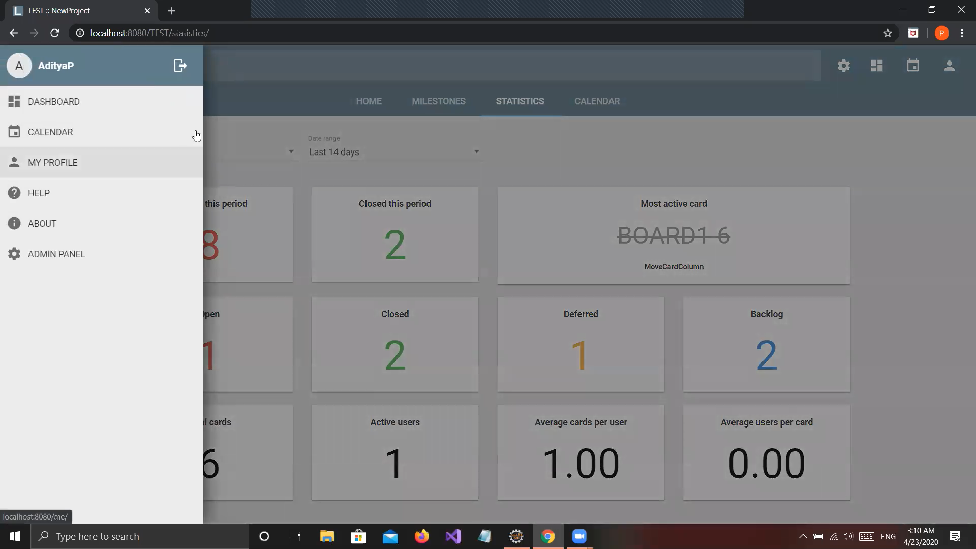
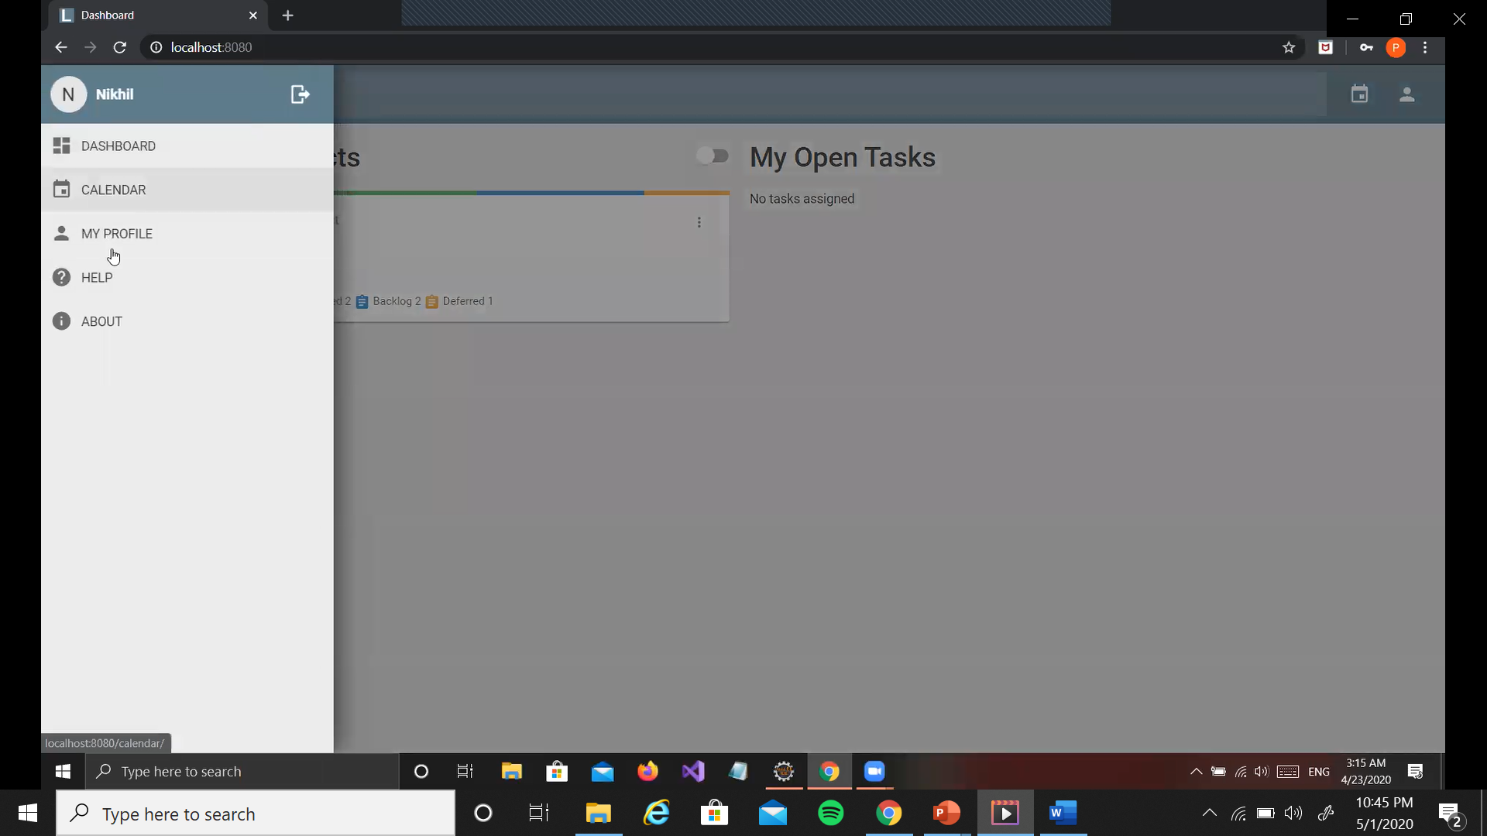
Menu
The three horizontal lines to the top left show the menu
Menu for an Admin user
Menu for a user

Slide 27
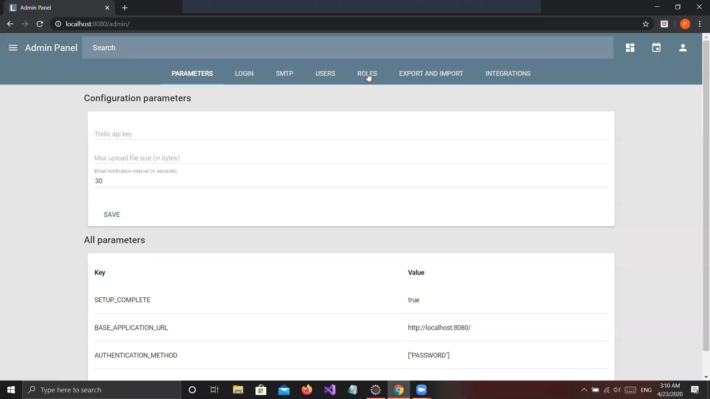
Admin Panel
This is specific to admin users. Allows the Administrator to check the details of the user and gives access controls and permissions for the users.

Slide 28
Parameters Tab
Shows the configuration parameters along with rest of the parameters

Slide 29
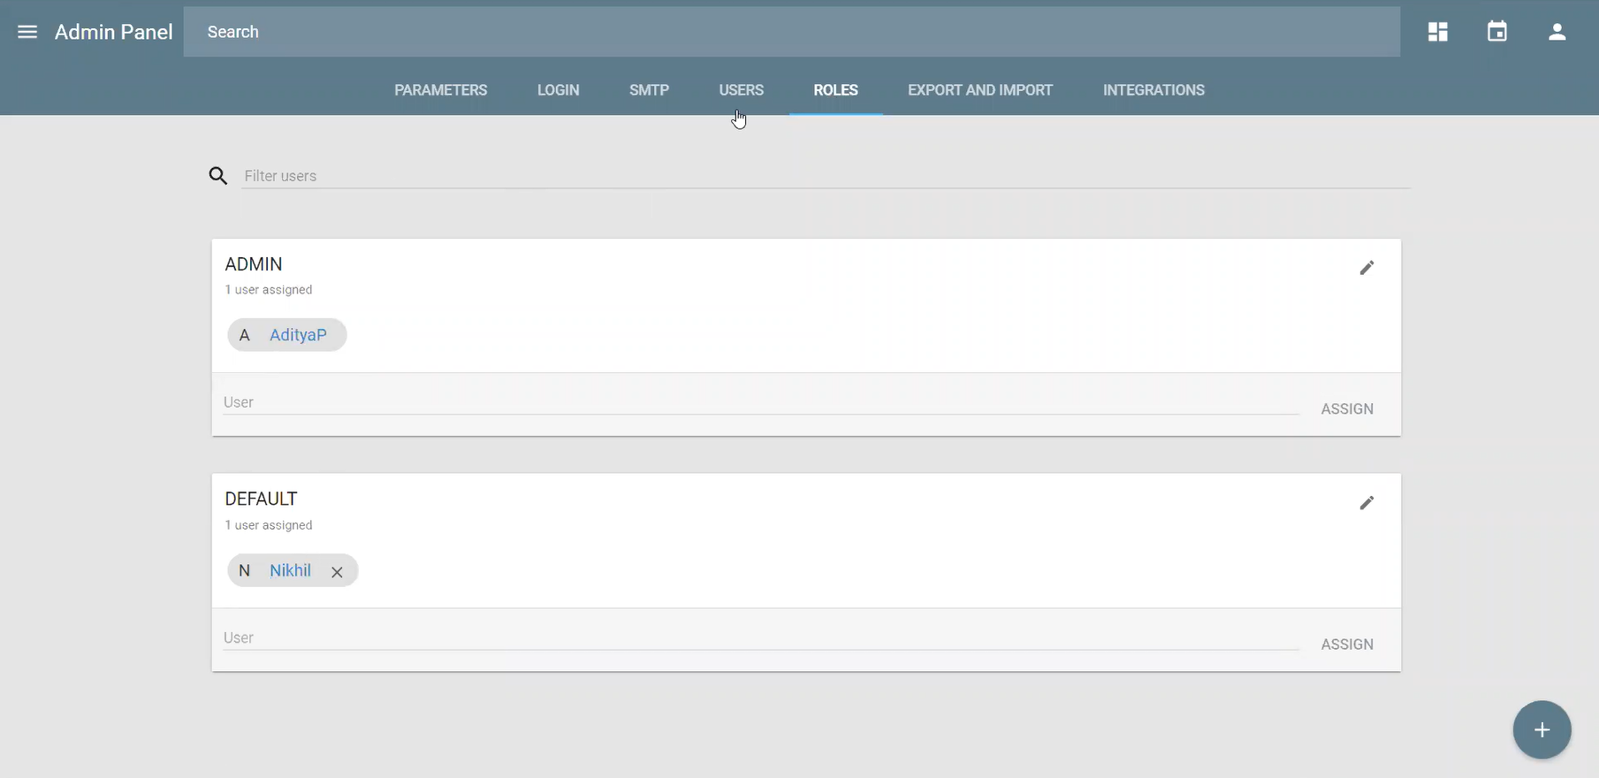
Roles Tab
Shows the roles of the admin and default inside the tabs

Slide 30
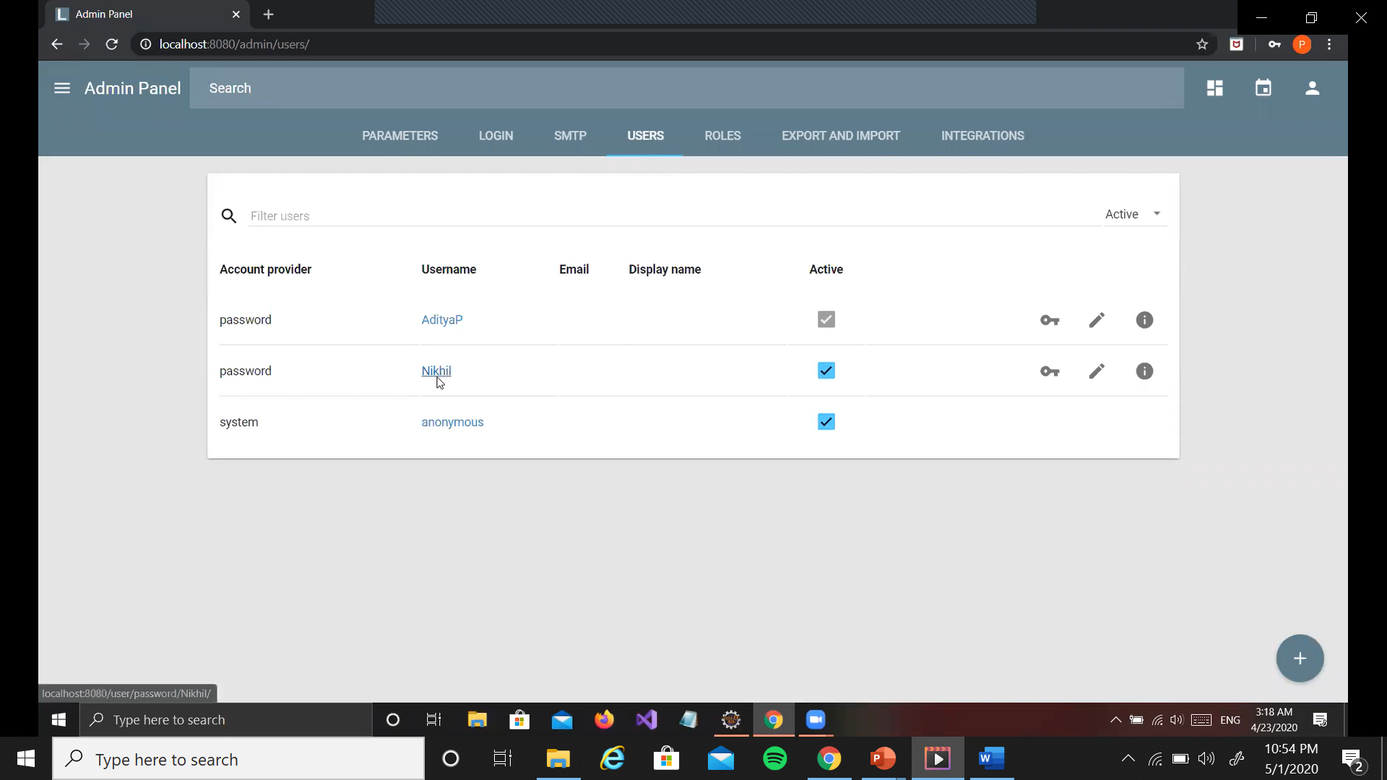
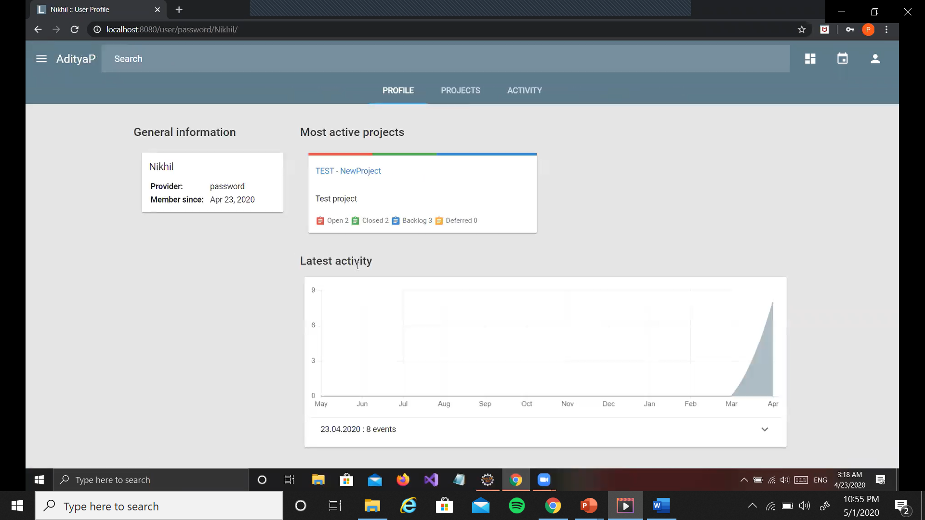
Users Tab
Shows the users created, an admin can also create a user using the + at the bottom right on selecting a user, the admin can check that user’s profile, projects and activity

Slide 31
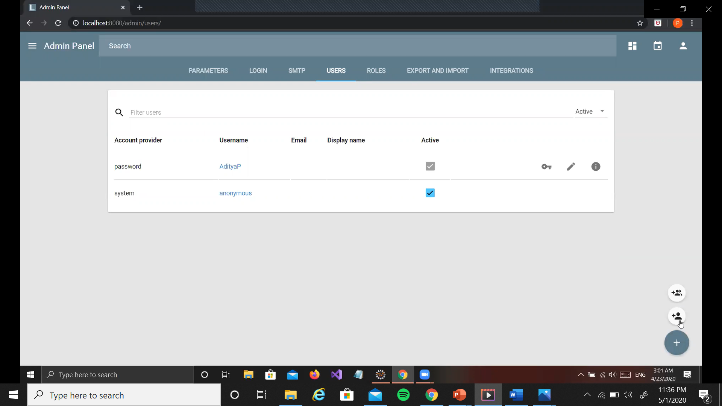
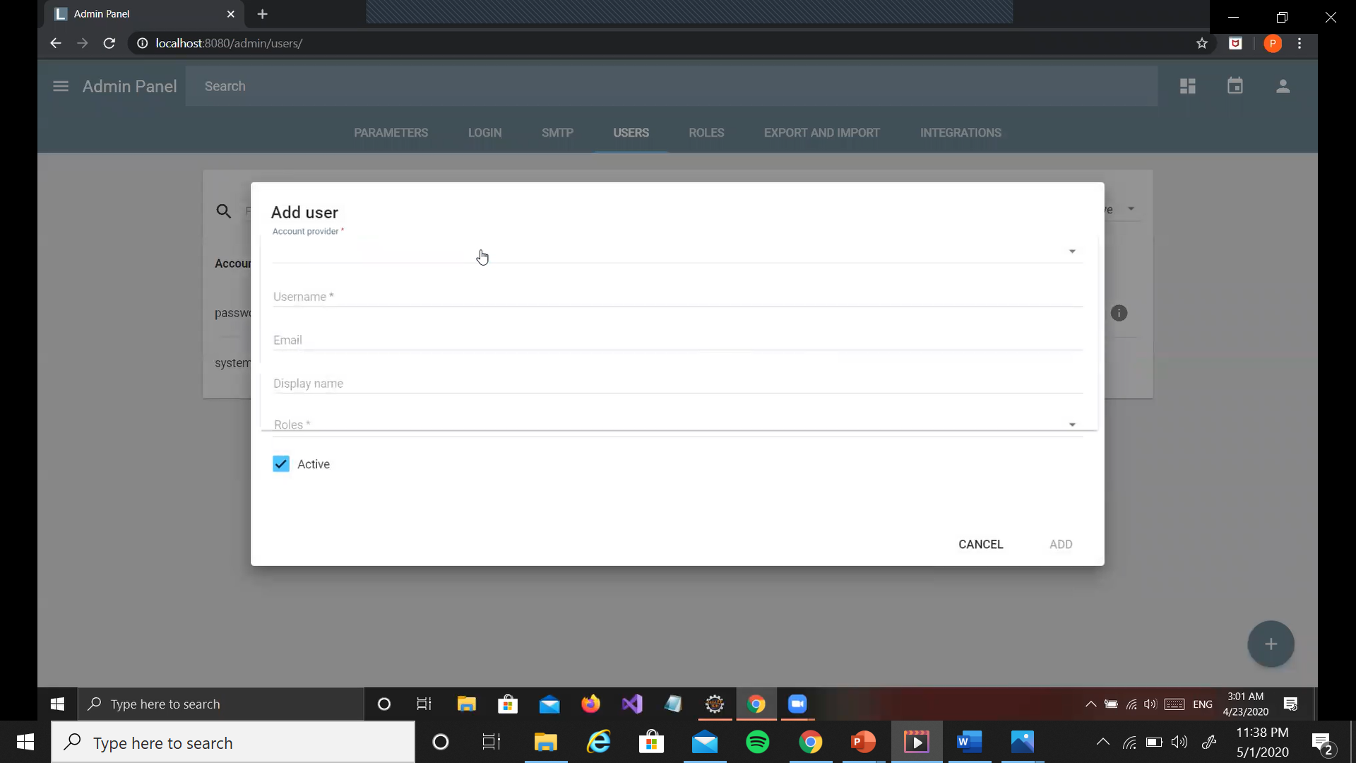
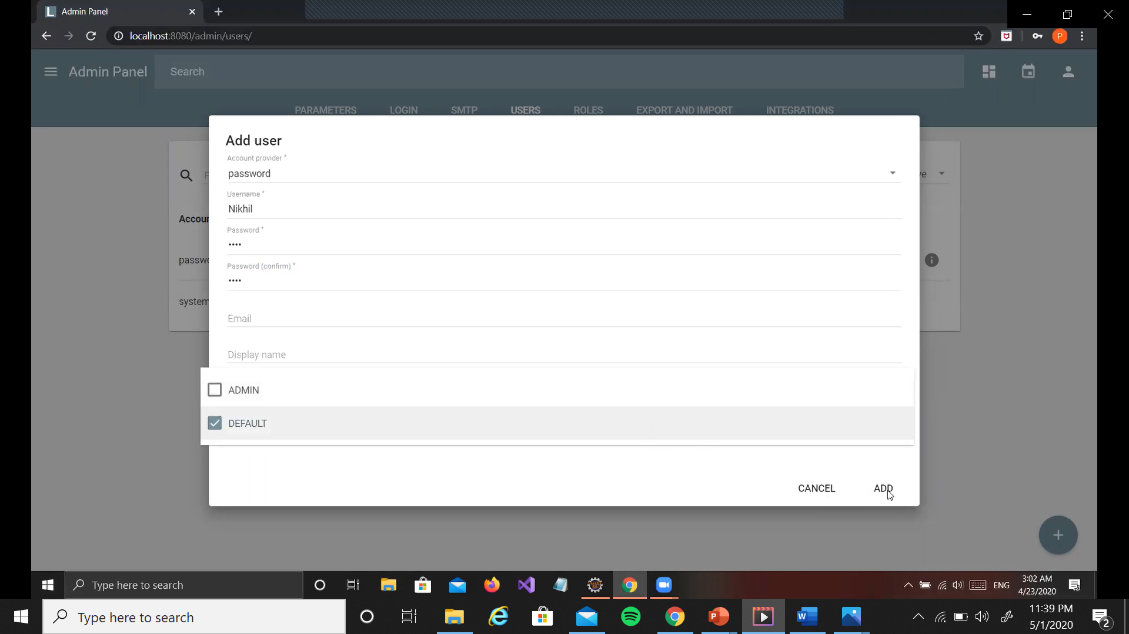
Create User
Admin can create a user
Details are entered by the admin
Role is selected through a drop-down menu

Slide 32
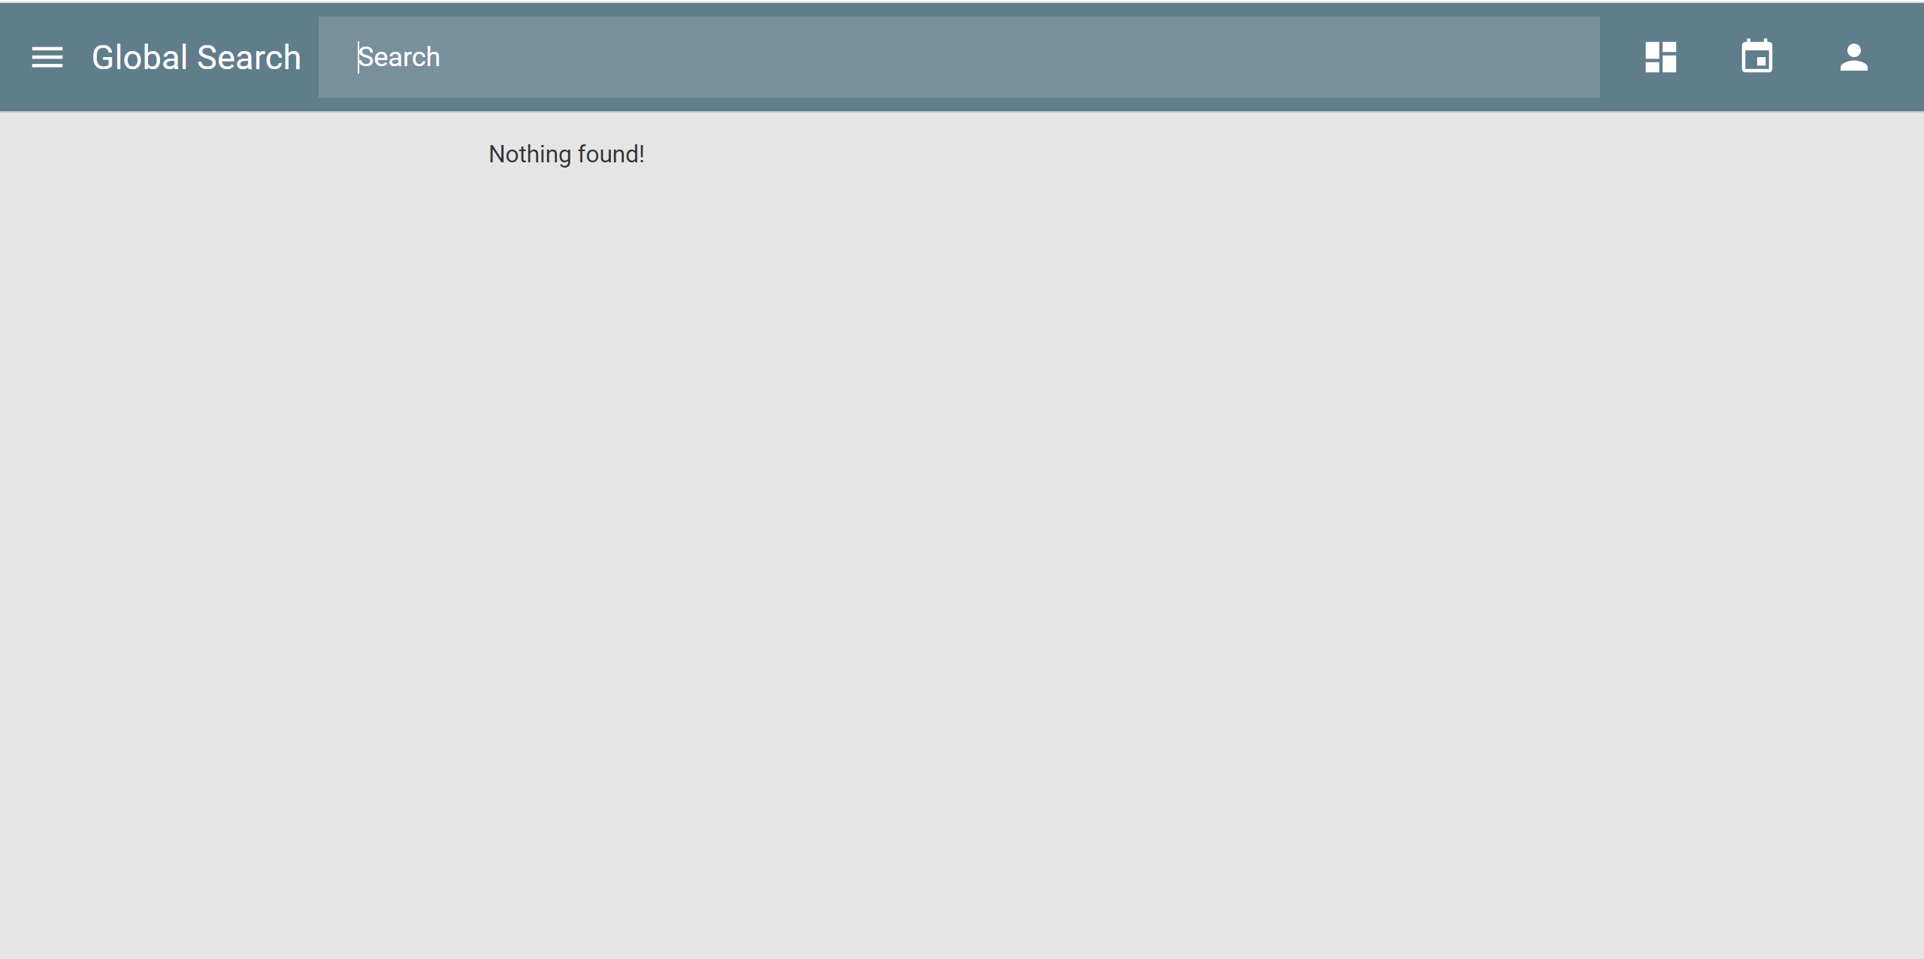
Search
Can search for projects, tasks

Slide 33
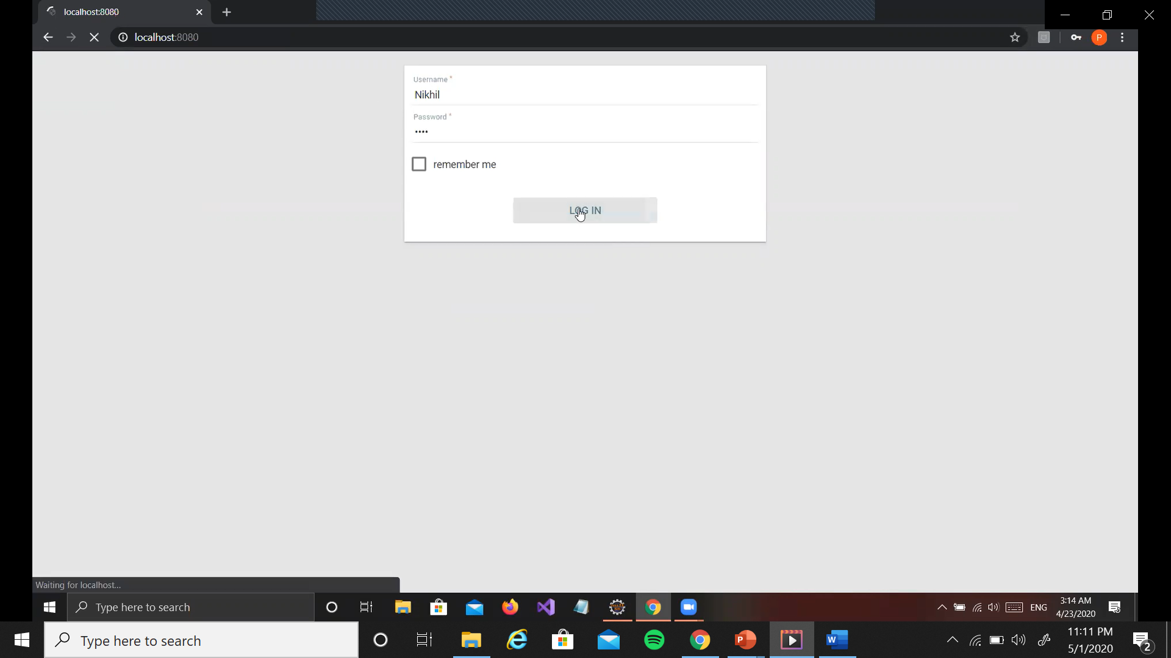
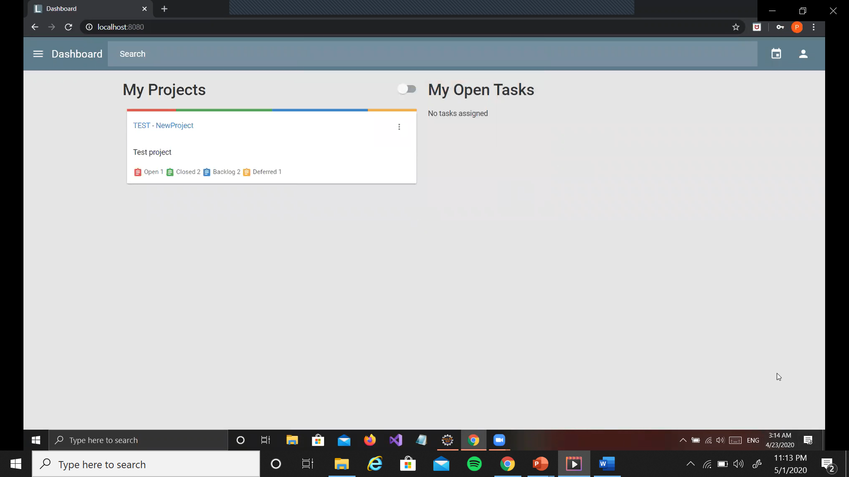
Client Login
Client user does not have the ability to change projects but can only view the progress. The absence of the + symbol to the bottom right on the dashboard shows that the client cannot add projects

Slide 34
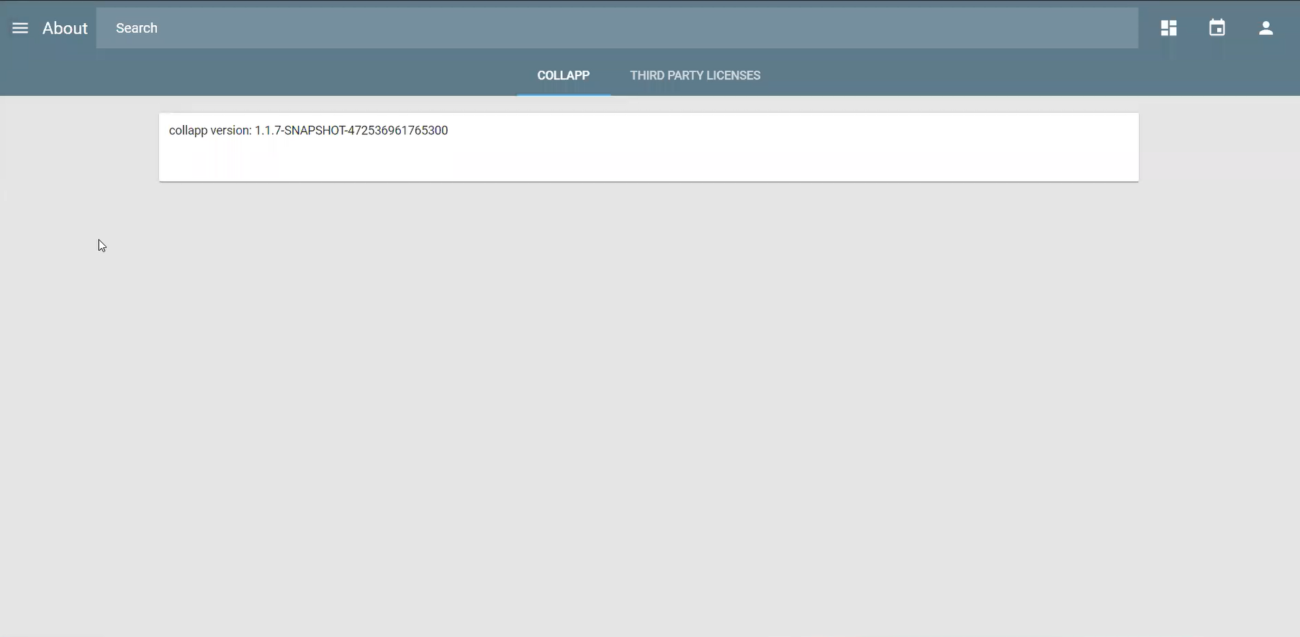
About
Shows the version of COLLAPP and licenses

Slide 35
Thank You!

